Slide 1

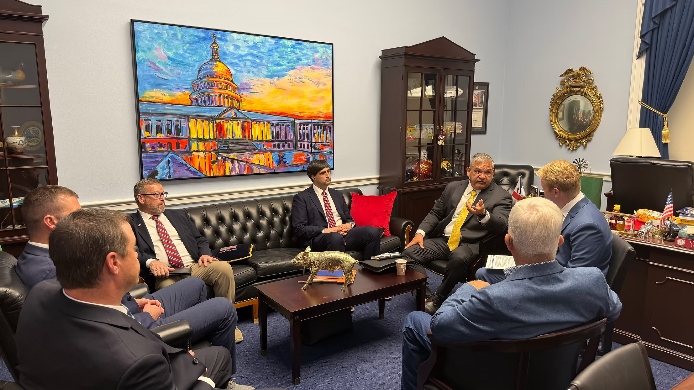
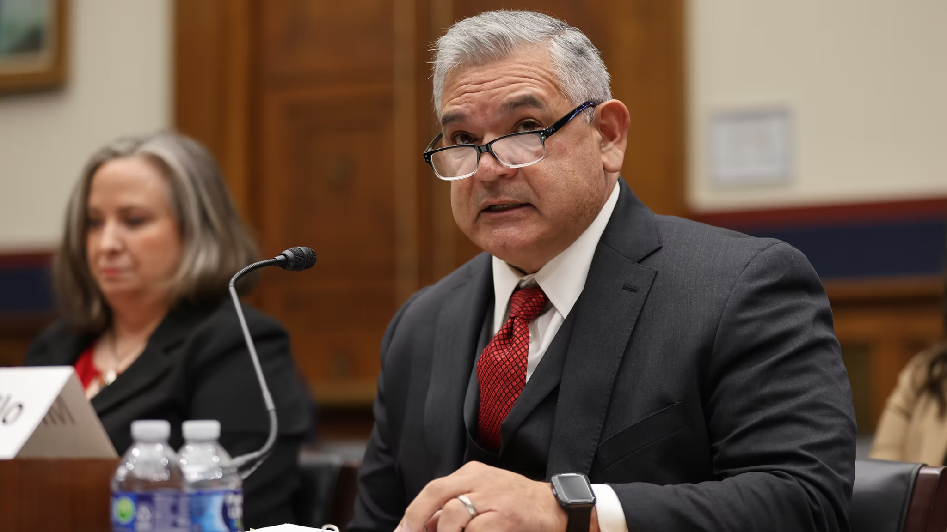
Charles Camillo
Executive Vice President
midwestfloodcontrol.org

