Slide 1
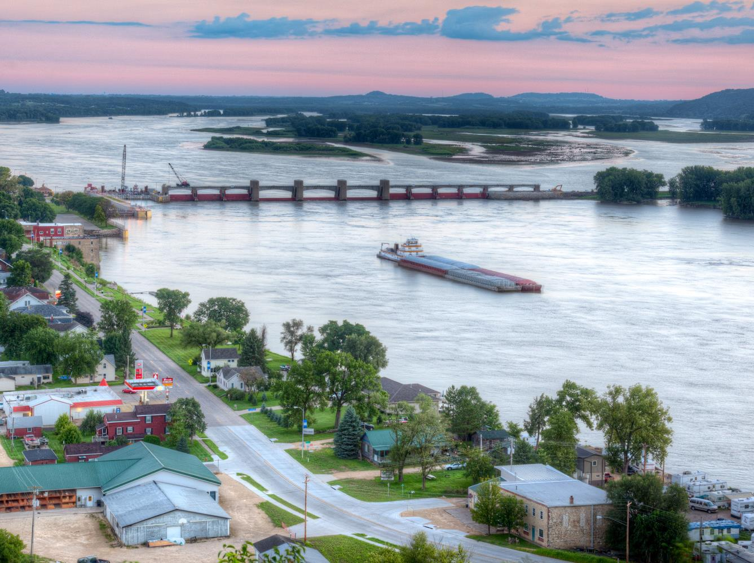


Inland Waterways Update
Corn Belt Ports & Mid-America Port Commission Annual Meeting
Charlie Purcell, Director
Transportation Development Division
July 30, 2026
Notes:
The Iowa DOT continues to be strong advocate for inland waterway navigation on the M-35 (Mississippi River) and M-29 (Missouri River) marine highways, as evidenced by our current waterway and freight activities.

Slide 2
Freight Advisory Council
Group of Iowa-based public and private stakeholders
Advisory body to the Iowa DOT on freight mobility policies, programs, and investments
Regularly discuss inland waterways as part of the larger freight transportation network
Inland waterways are represented by the Rock Island and Omaha Districts of the U.S. Army Corps of Engineers, Artco Fleeting, Port of Blencoe (NEW Cooperative), and the Mid-America Port Commission
Notes:
The Iowa Freight Advisory Council continues to meet for quarterly meetings. The FAC is a group of Iowa-based public and private stakeholders serving as an advisory body to the Iowa DOT on freight mobility policies, programs, and investments. The inland waterways are represented by the Rock Island and Omaha Districts of the U.S. Army Corps of Engineers, Artco Fleeting, the Port of Blencoe, and the Mid-America Port Commission.

Slide 3
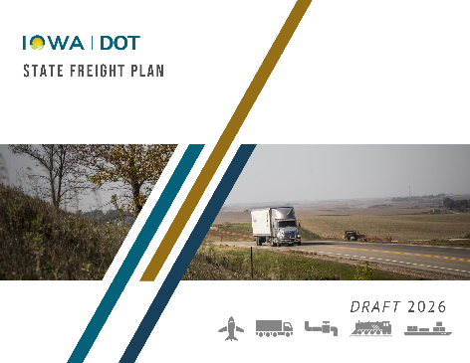
State Freight Plan
Developed with the Iowa FAC and submitted to FHWA for review in May (anticipating approval prior to our August deadline)
Contains inland waterway content and actions (freight networks, inventory, condition, bottlenecks, strategies, and improvements)
Exploring a State Waterway Program – currently examining maritime funding programs in neighboring states and planning an Iowa FAC working group to discuss the topic of port development needs in Iowa
Notes:
The updated State Freight Plan developed with the Iowa FAC was submitted to FHWA for review in May and we’re anticipating approval prior to our August deadline. This updated document, as well as the previous 2022 and 2017 versions, contains significant inland waterway content and actions.
Freight networks
The M-35 (Mississippi River) and M-29 (Missouri River) are included as part of the National Multimodal Freight Network and Iowa Multimodal Freight Network, both of which are used for long range planning and investment considerations.
Inventory and condition
Overview of the M-35, M-29, 11 lock and dams, and, 70 private barge terminals, most of which are located within the boundaries of multiple port statistical areas and port authorities.
Highlights the need for additional investment in inland waterway infrastructure and the waterways themselves to improve reliability and efficiency.
Bottlenecks
Given the condition, size and average delay of the 11 locks bordering Iowa, all are considered freight bottlenecks. Additionally, 11 swing-span bridges over the Mississippi River in Iowa are also considered bottlenecks.
Implementation strategies
The Iowa FAC assisted in the development and prioritization of freight-specific implementation strategies, including the following directly related to inland waterways.
Improve freight transportation system resiliency (#1 of 21)
Advance a 21st century Farm-to-Market System that moves products seamlessly across road, rail, and water to global marketplaces (#7)
Advocate for the funding and improvement of the inland waterway system and explore ways to expand Iowa's role (#11)
The Iowa DOT is currently examining maritime programs in neighboring states and planning a working group made up of FAC members to examine the topic of port development needs in Iowa.
Target investment in the Iowa Multimodal Freight Network (IMFN) at a level that reflects the importance of this system for moving freight (#12)
Improvement lists
A list of deferred/backlog maintenance projects for Iowa locks and dams is included.

Slide 4
Marine Highways
M-35 (Twin Cities to the Illinois River)
  Regularly coordinate with other M-35 sponsors (Iowa, Illinois, Minnesota, Missouri, and Wisconsin DOTs) and the Upper Mississippi River Basin Association
  Sponsors recently developed a list of considerations for state endorsement of MARAD funding applications, States may elect to use these criteria when considering endorsement for grant applications along the M-35
M-29 (Sioux City to Kansas City)
  The Iowa DOT submitted an application to MARAD in June to be added as a route sponsor (with support from current sponsors Port KC and Missouri DOT)
  Missouri River has vast potential and will be an economic boon in the future
Notes:
The Iowa DOT recently worked closely with the M-35 marine highway sponsors and the Upper Mississippi River Basin Association to develop a list of considerations for state endorsement of MARAD funding applications. States may elect to use these criteria when considering endorsement for grant applications along the M-35.
The Iowa DOT submitted an application to MARAD in June, with the support of Port KC and the Missouri DOT, to be added as a route sponsor of the M-29 marine highway. The State of Iowa believes that the Missouri River has vast potential and will be an economic boon in the future. Therefore, an application was submitted to be able to support and assist Port KC and the Missouri DOT with these efforts.

Slide 5
Questions?
CHARLIE PURCELL
515-239-1592
charlie.purcell@iowadot.us​
iowadot.gov

