Slide 1
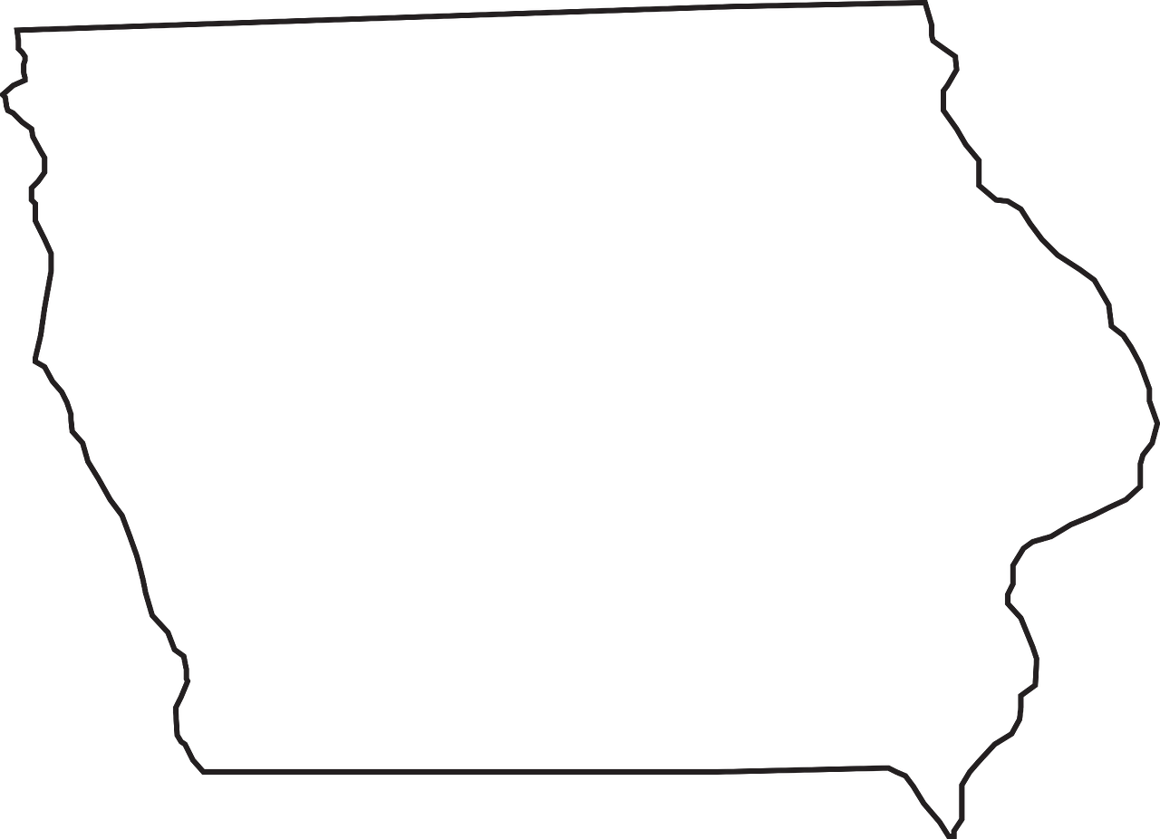


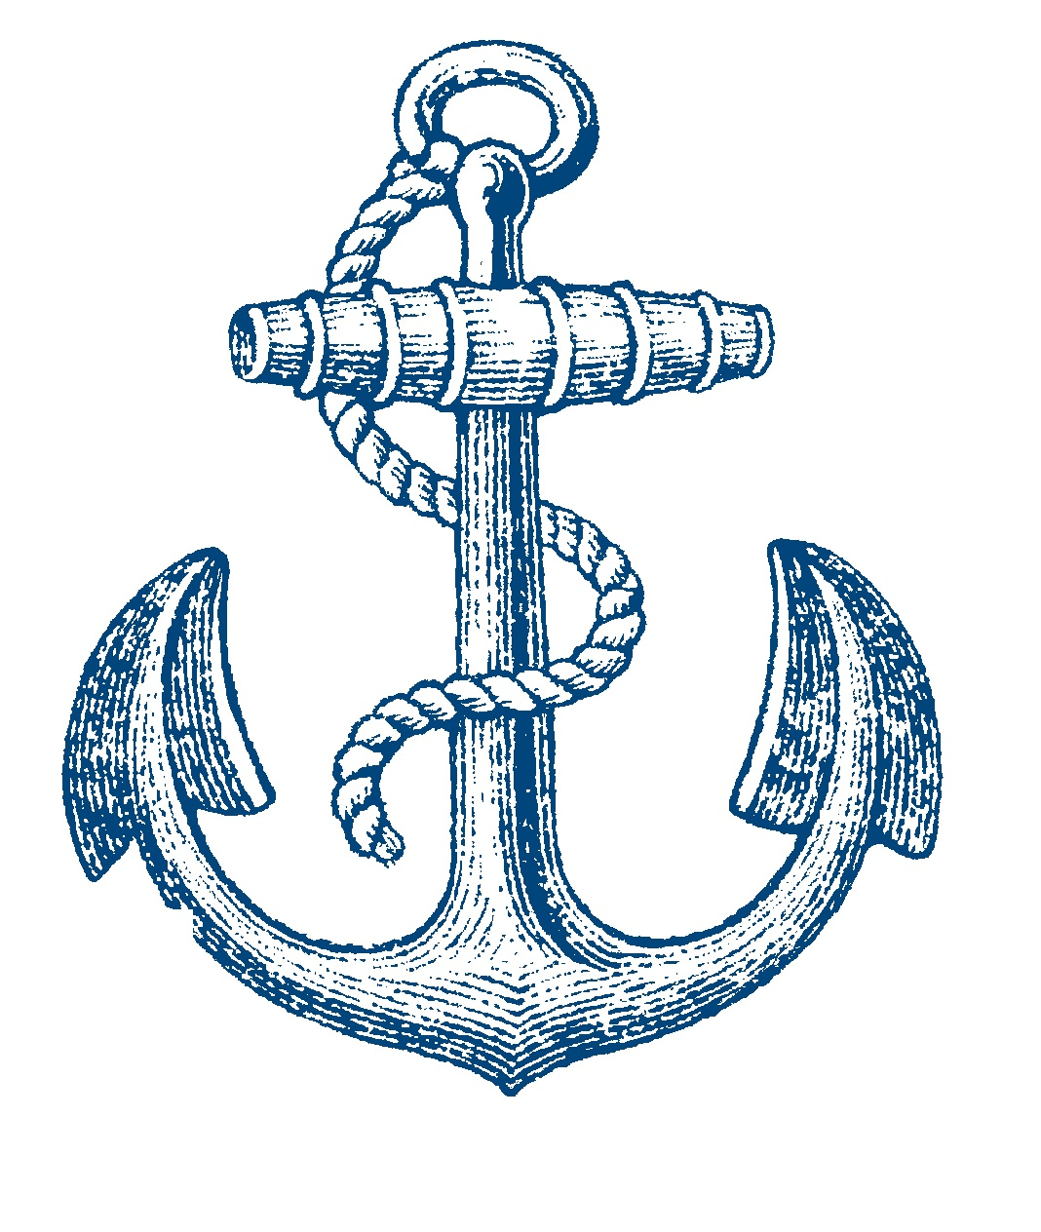
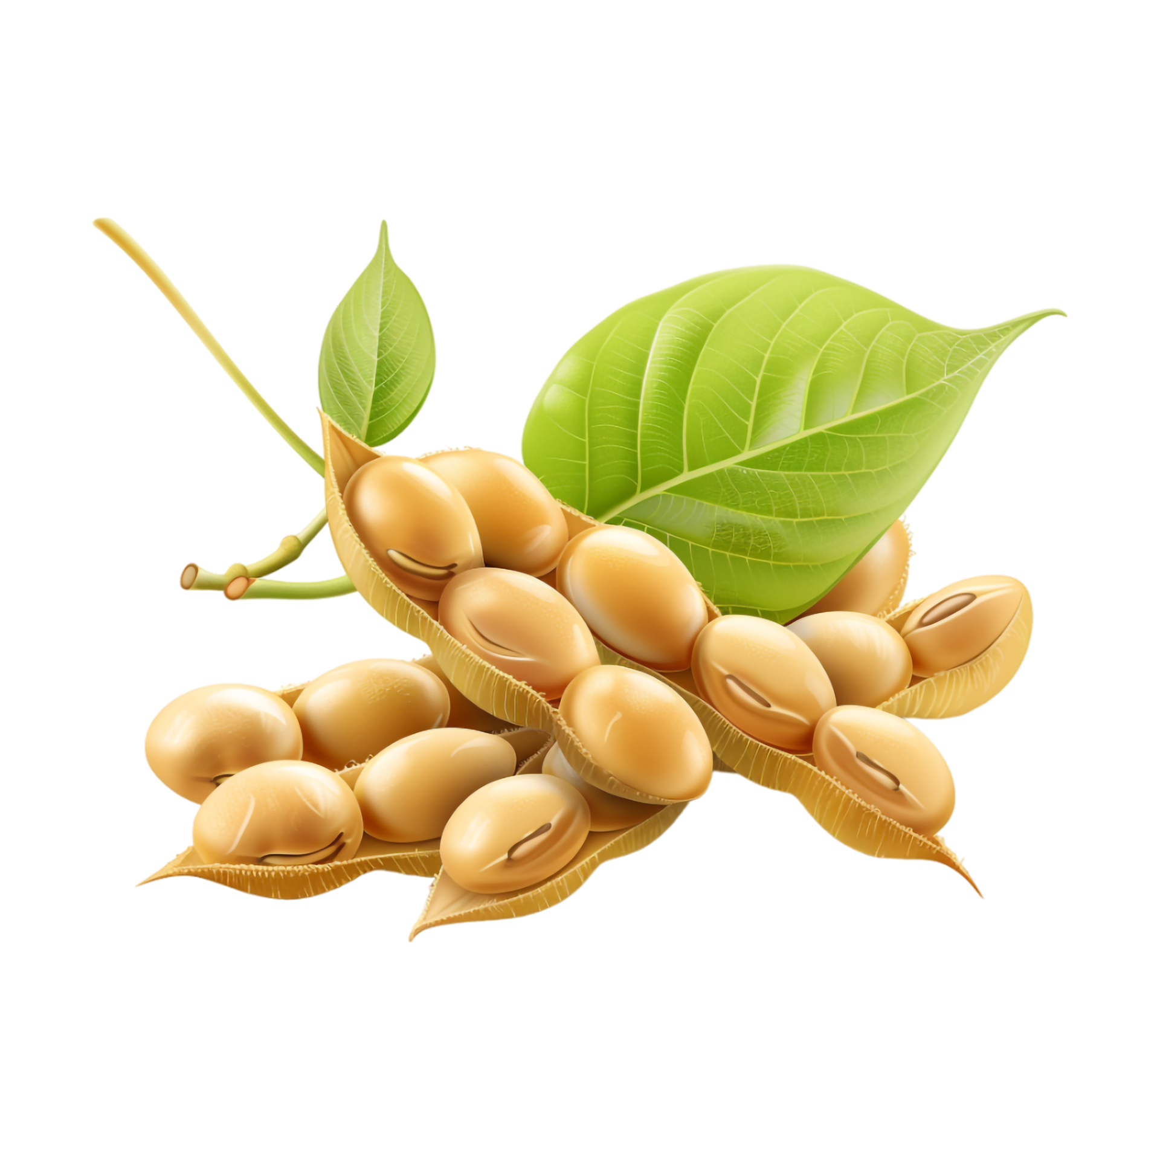

IOWA PORTS
ASSOCIATION
Serving the Rural, Regional, Inland Ports on
Iowa’s East and West Coasts

Slide 2
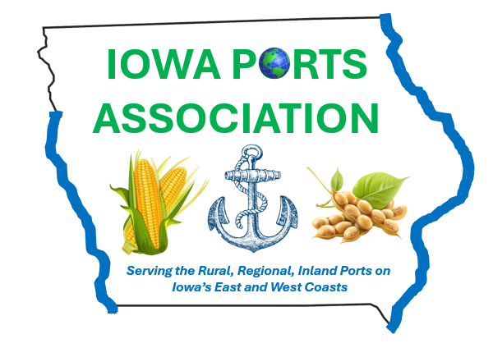

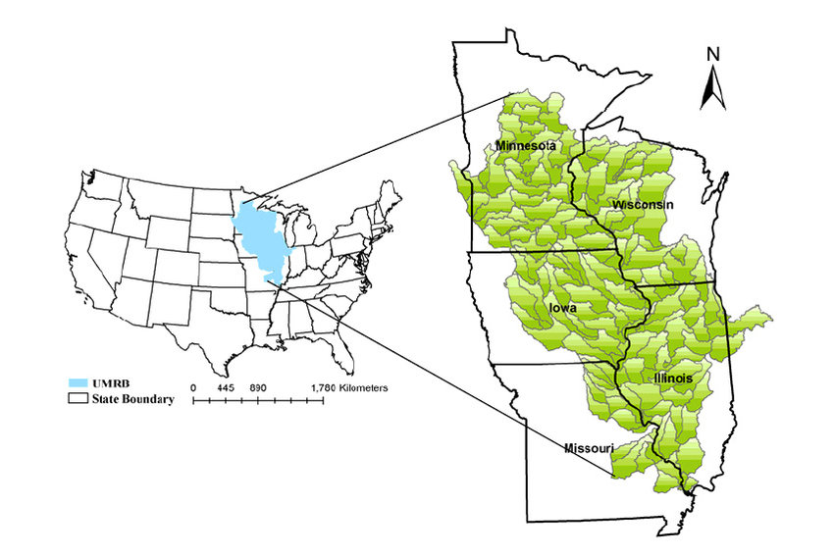

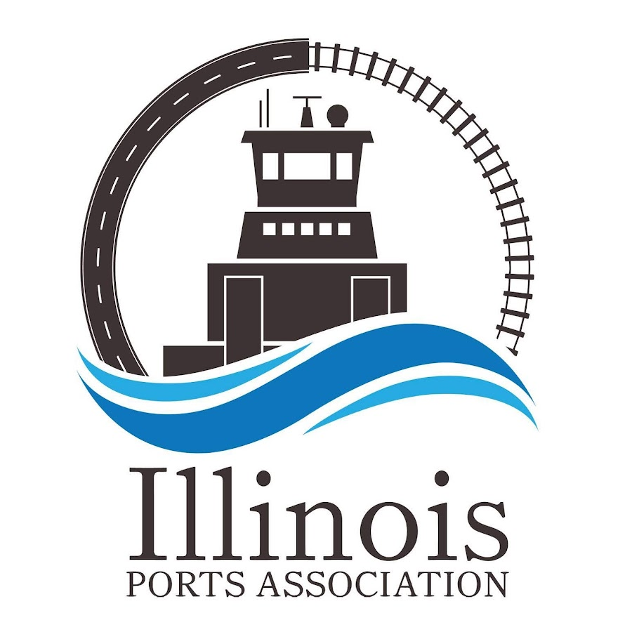

Upper Mississippi River Basin
State Ports Associations
Iowa Was
Missing
X
Pre 2025

Slide 3
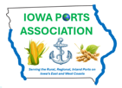
Upper Mississippi River Basin Ports Associations (2025)
Today

Slide 4
Iowa is the #2 Agriculture
Product Export State in the U.S.
Competing in the Current Export Market
Requires Modern Inland Ports
Iowa plays a crucial role in the U.S. export landscape, particularly in agriculture and manufacturing. The state's ability to adapt to changing global markets and maintain a diverse export portfolio is vital for its economic health and job creation. The continued growth in exports reflects Iowa's strategic importance in international trade.
https://www.worldstopexports.com/iowas-top-10-exports/#:~:text=Iowa%20generated%20an%20overall

Slide 5
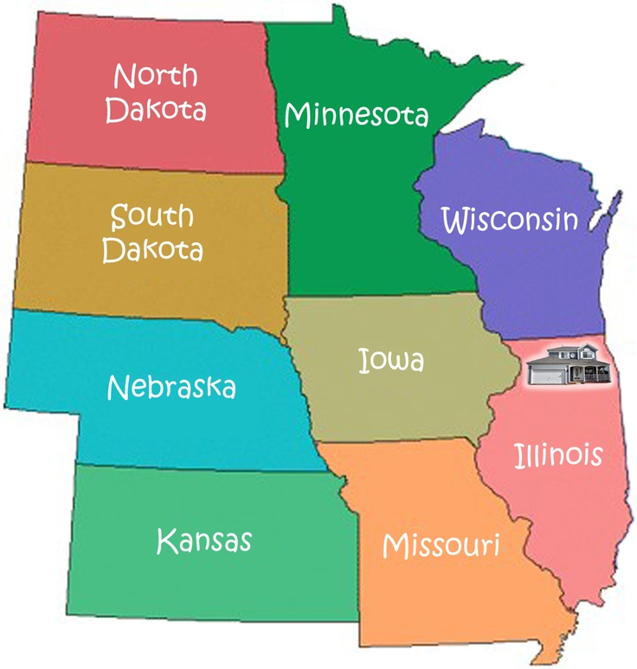
Top 10 U.S. Agriculture
Exporting States
#9
#4
#15
(2023)
#5
#2
#3
#10
#8
https://www.ers.usda.gov/data-products/state-agricultural-trade-data/annual-state-agricultural-exports

Slide 6
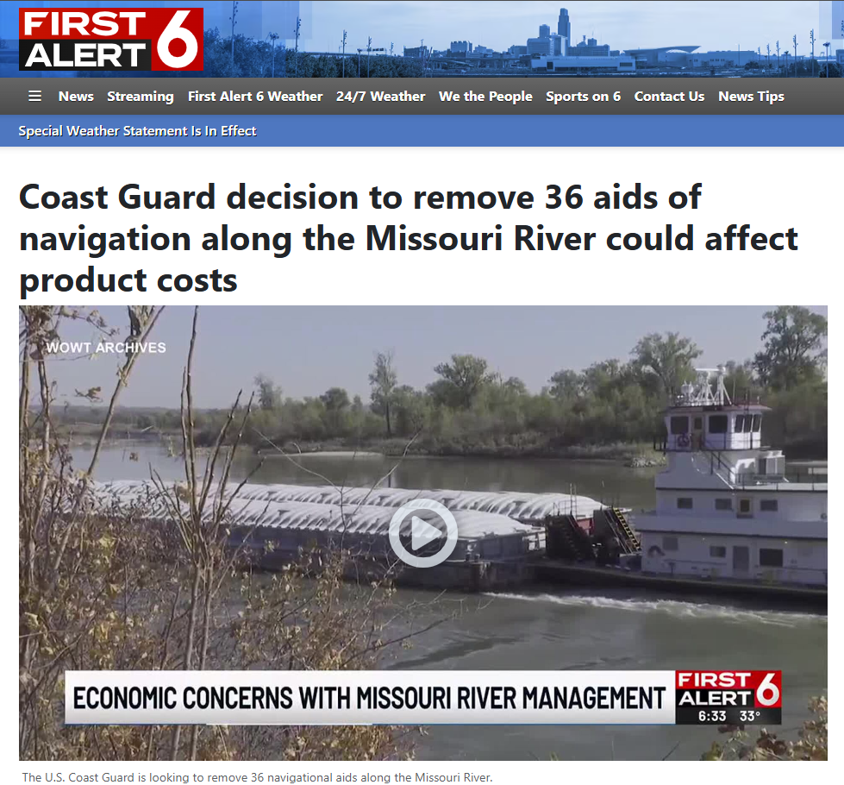
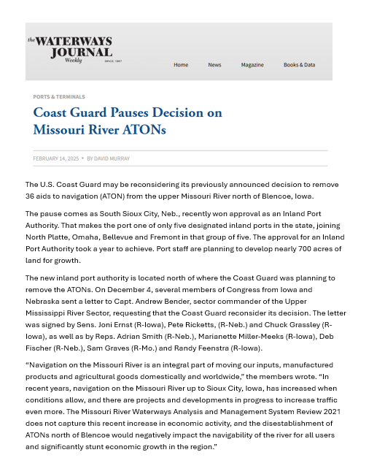
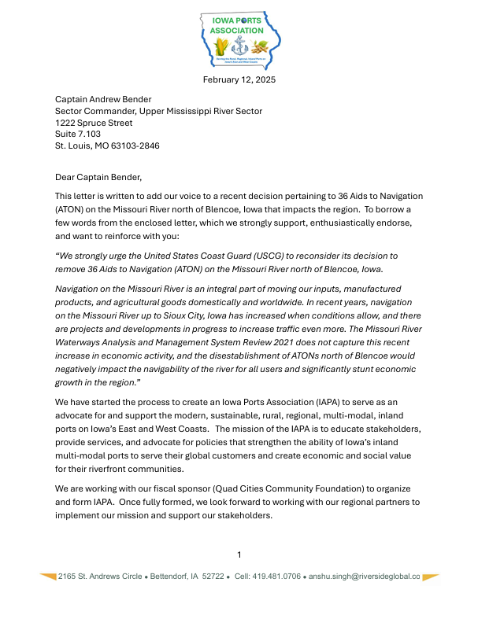
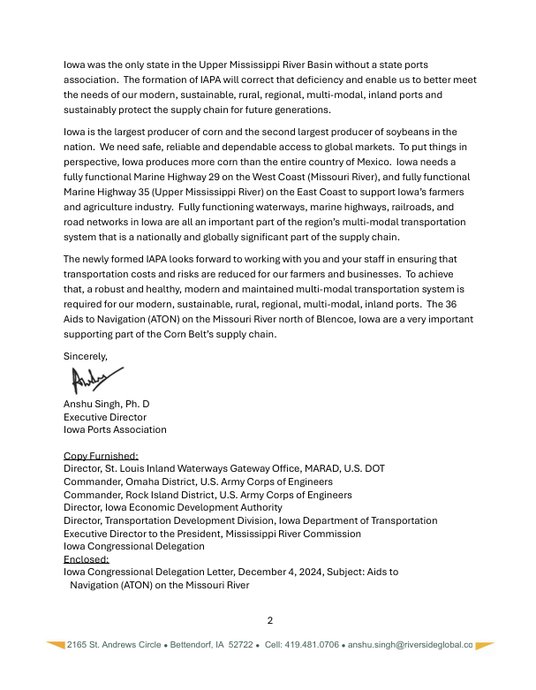

Slide 7
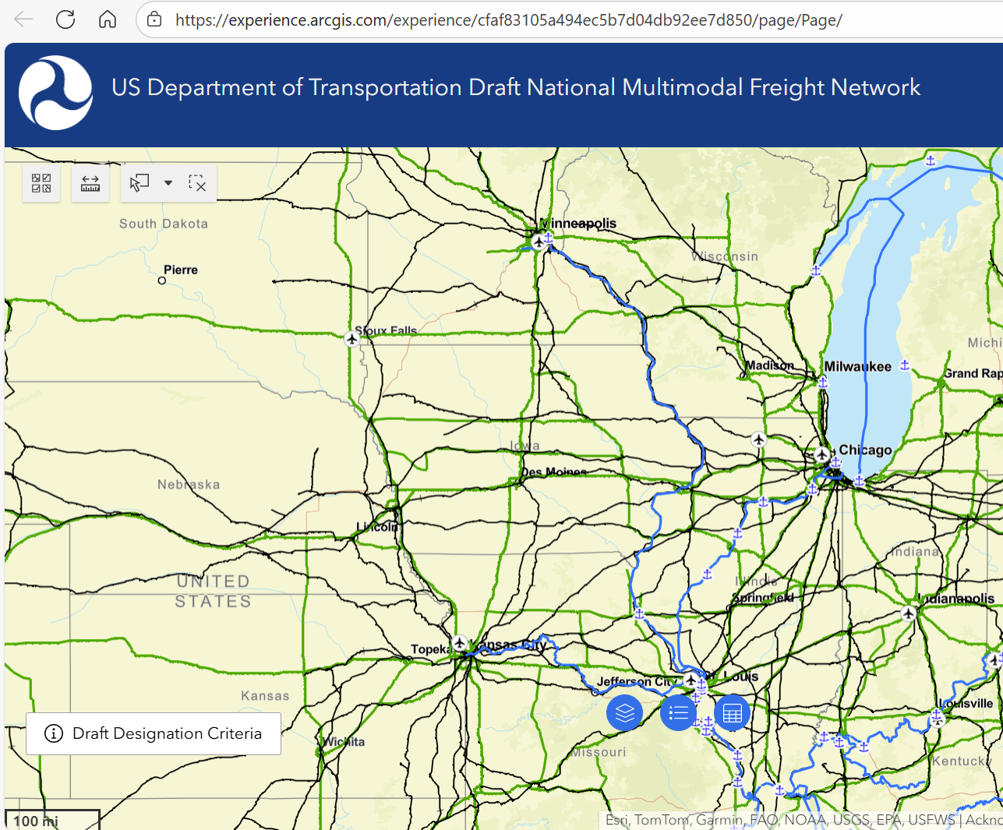
Feb 2025
Iowa Ports
Missing

Slide 8
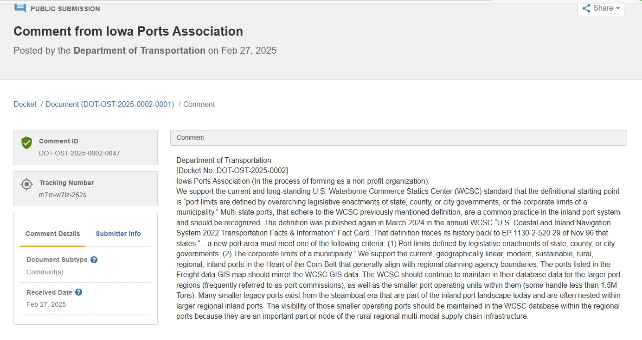

Slide 9
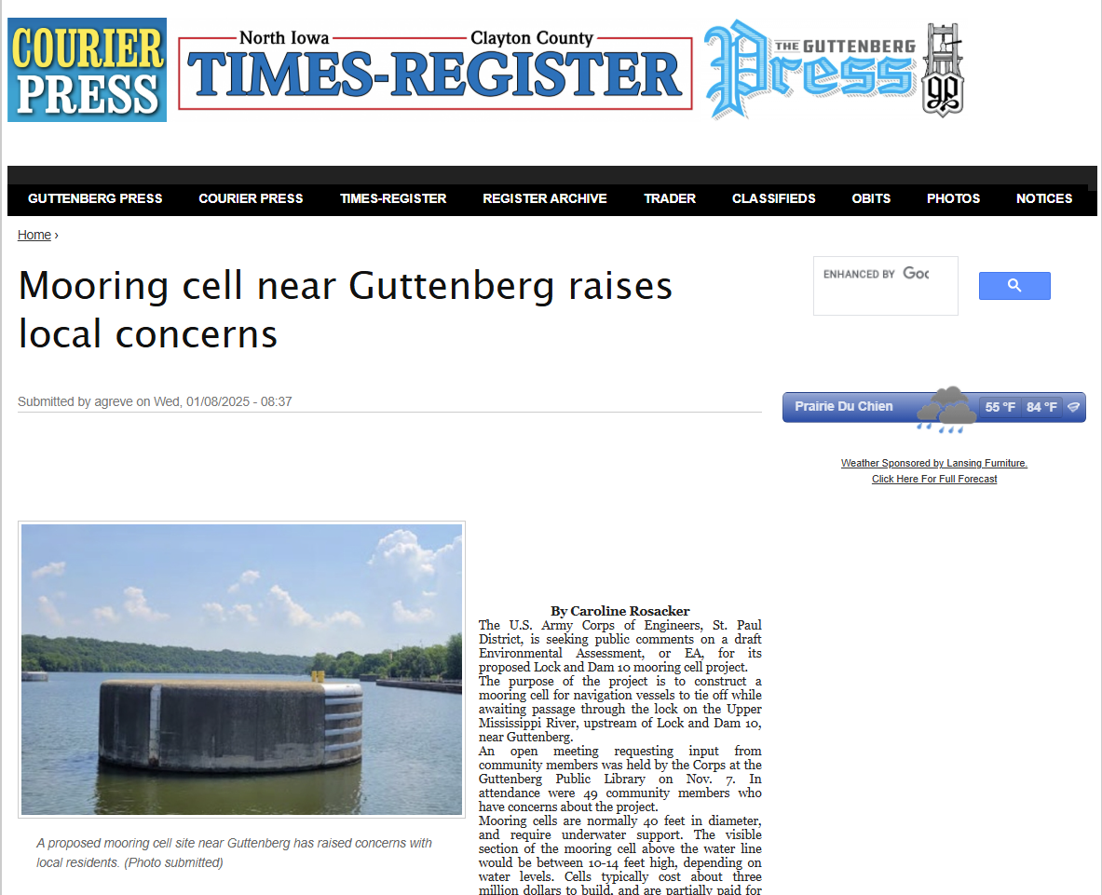

Slide 10
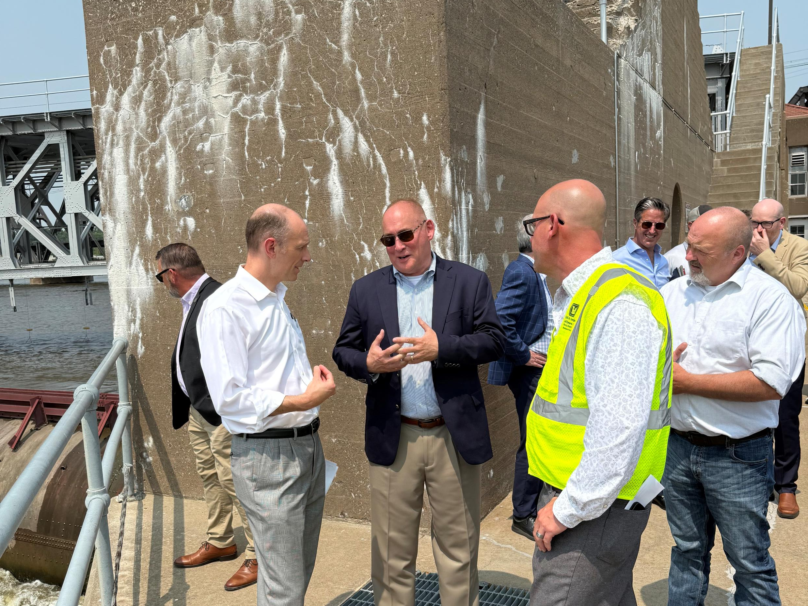
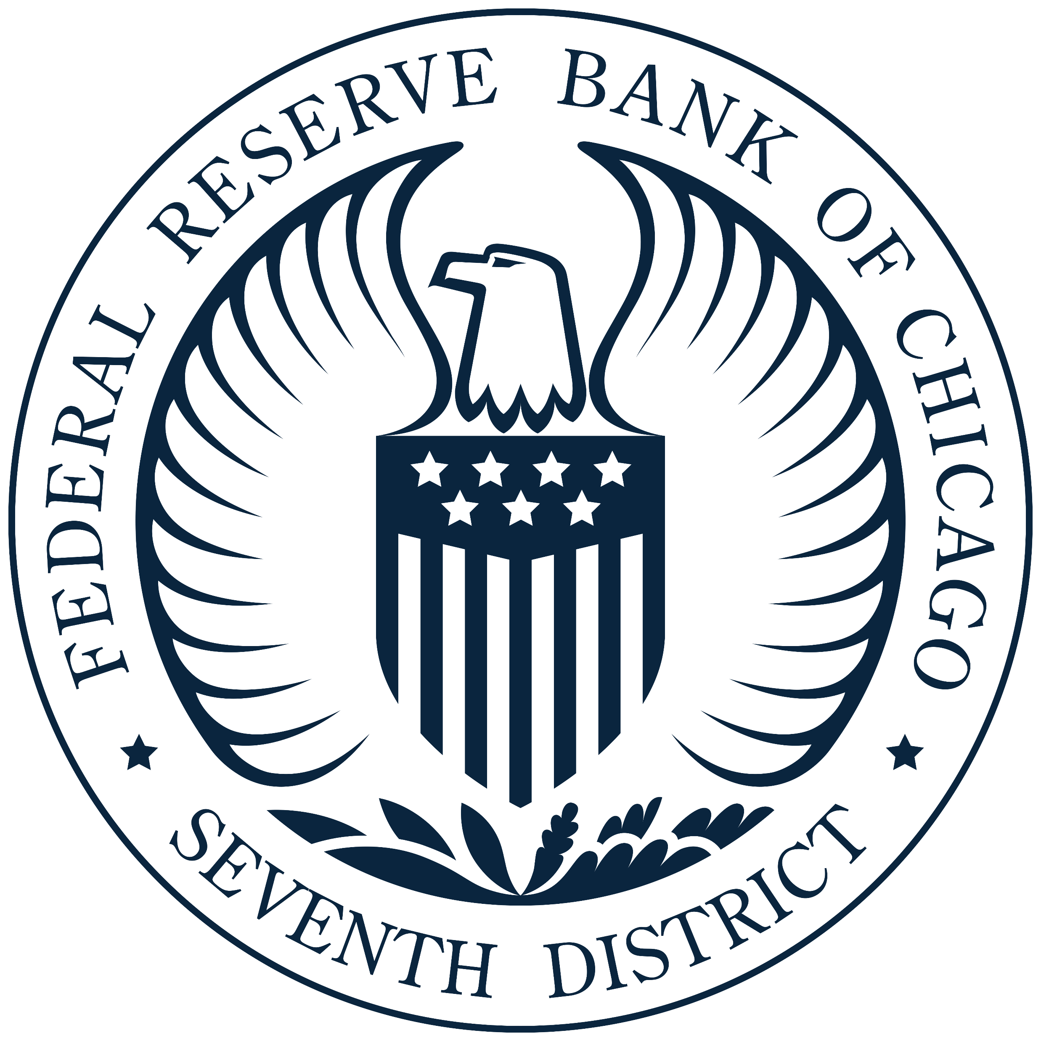
Locks and
Dam 15
June 2, 2025

Slide 11
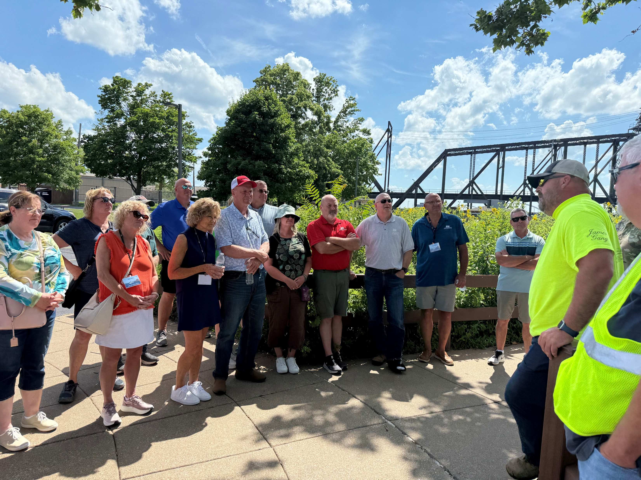

Locks and
Dam 15
Locks and
Dam 15
June 26, 2025

Slide 12
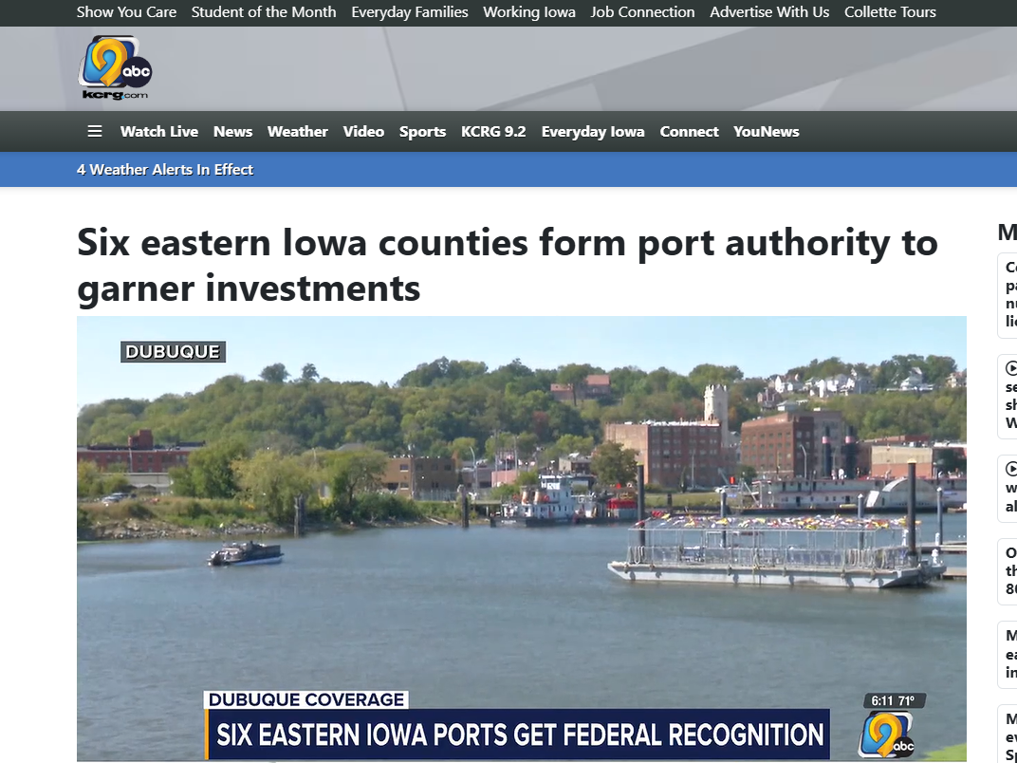


Slide 13
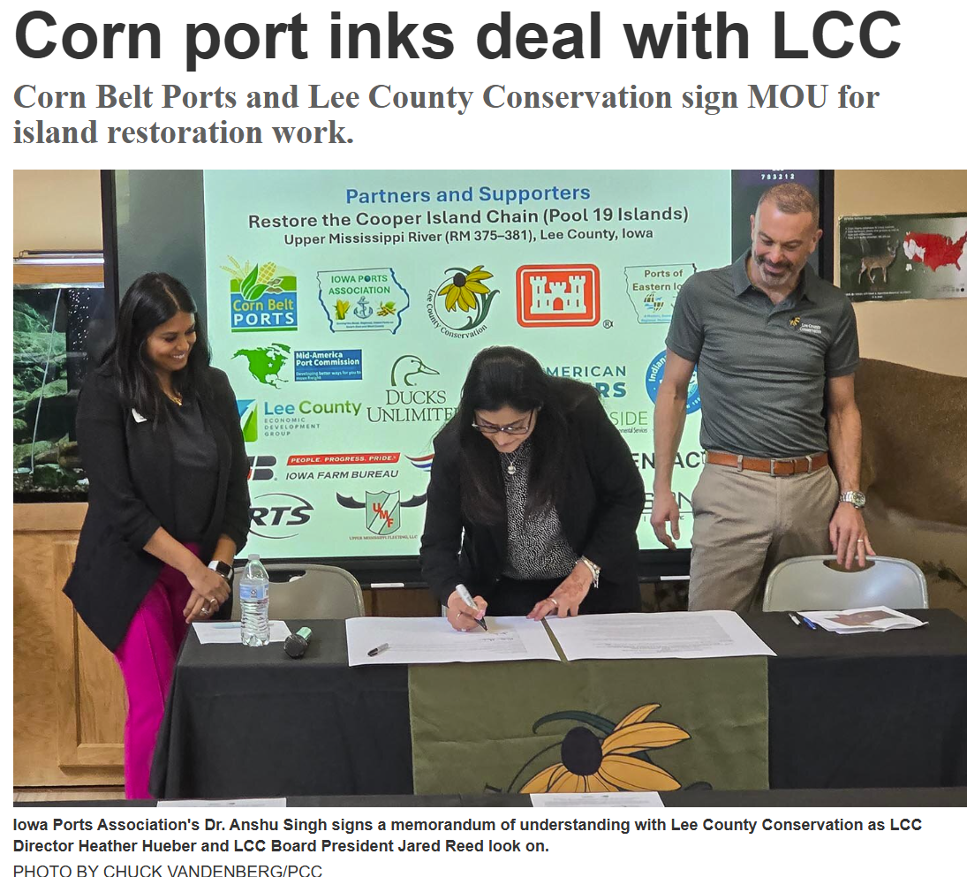
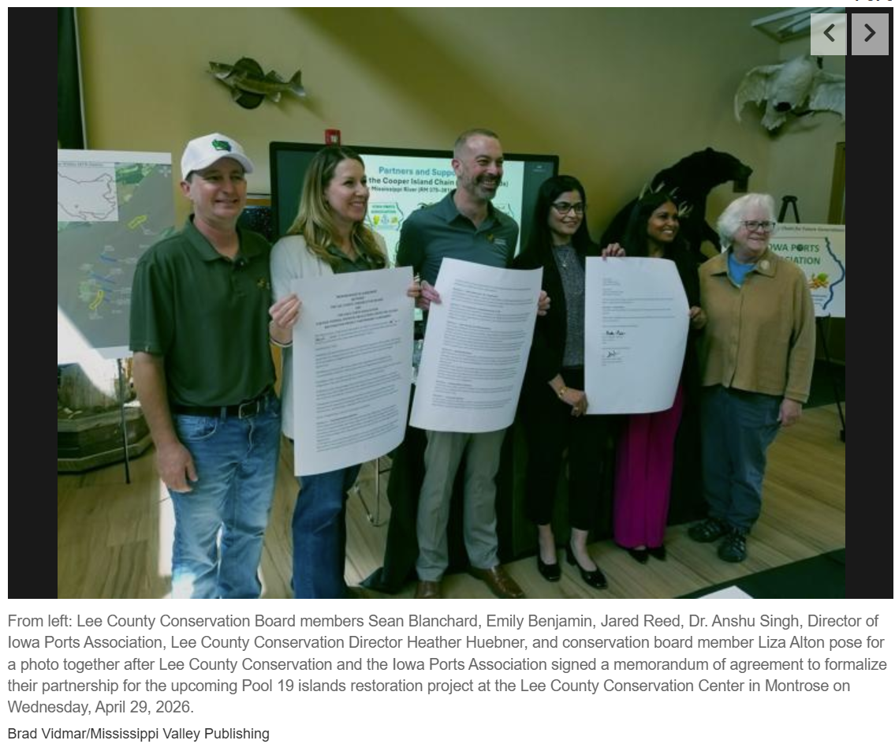
Cooper Island Chain Restoration Project
IAPA-Lee County Conservation Board (LCCB) MOU signed
https://www.pencitycurrent.com/stories/corn-port-inks-deal-with-lcc,167056
https://www.mississippivalleypublishing.com/the_hawk_eye/island-restoration-partnership-made-official/article_d9c99743-1c63-4881-9fa5-4242215cee11.html
https://www.wgem.com/2026/04/30/restoration-efforts-cooper-island-continue/
https://www.mississippivalleypublishing.com/daily_gate/island-restoration-partnership-made-official/article_ac2462fd-ec95-430f-b5e3-717386dee975.html
https://www.mississippivalleypublishing.com/daily_democrat/island-restoration-partnership-made-official/article_5716c807-a954-411f-9734-1204f10677c7.html
https://kilj.com/41-acre-island-restoration-project-moves-closer-with-new-funding-backing/

Slide 14
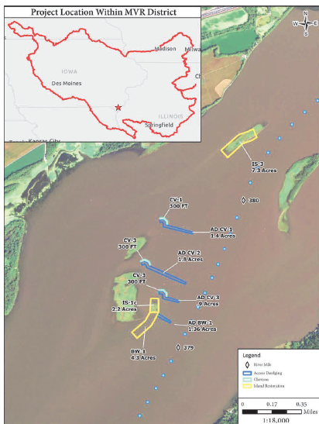
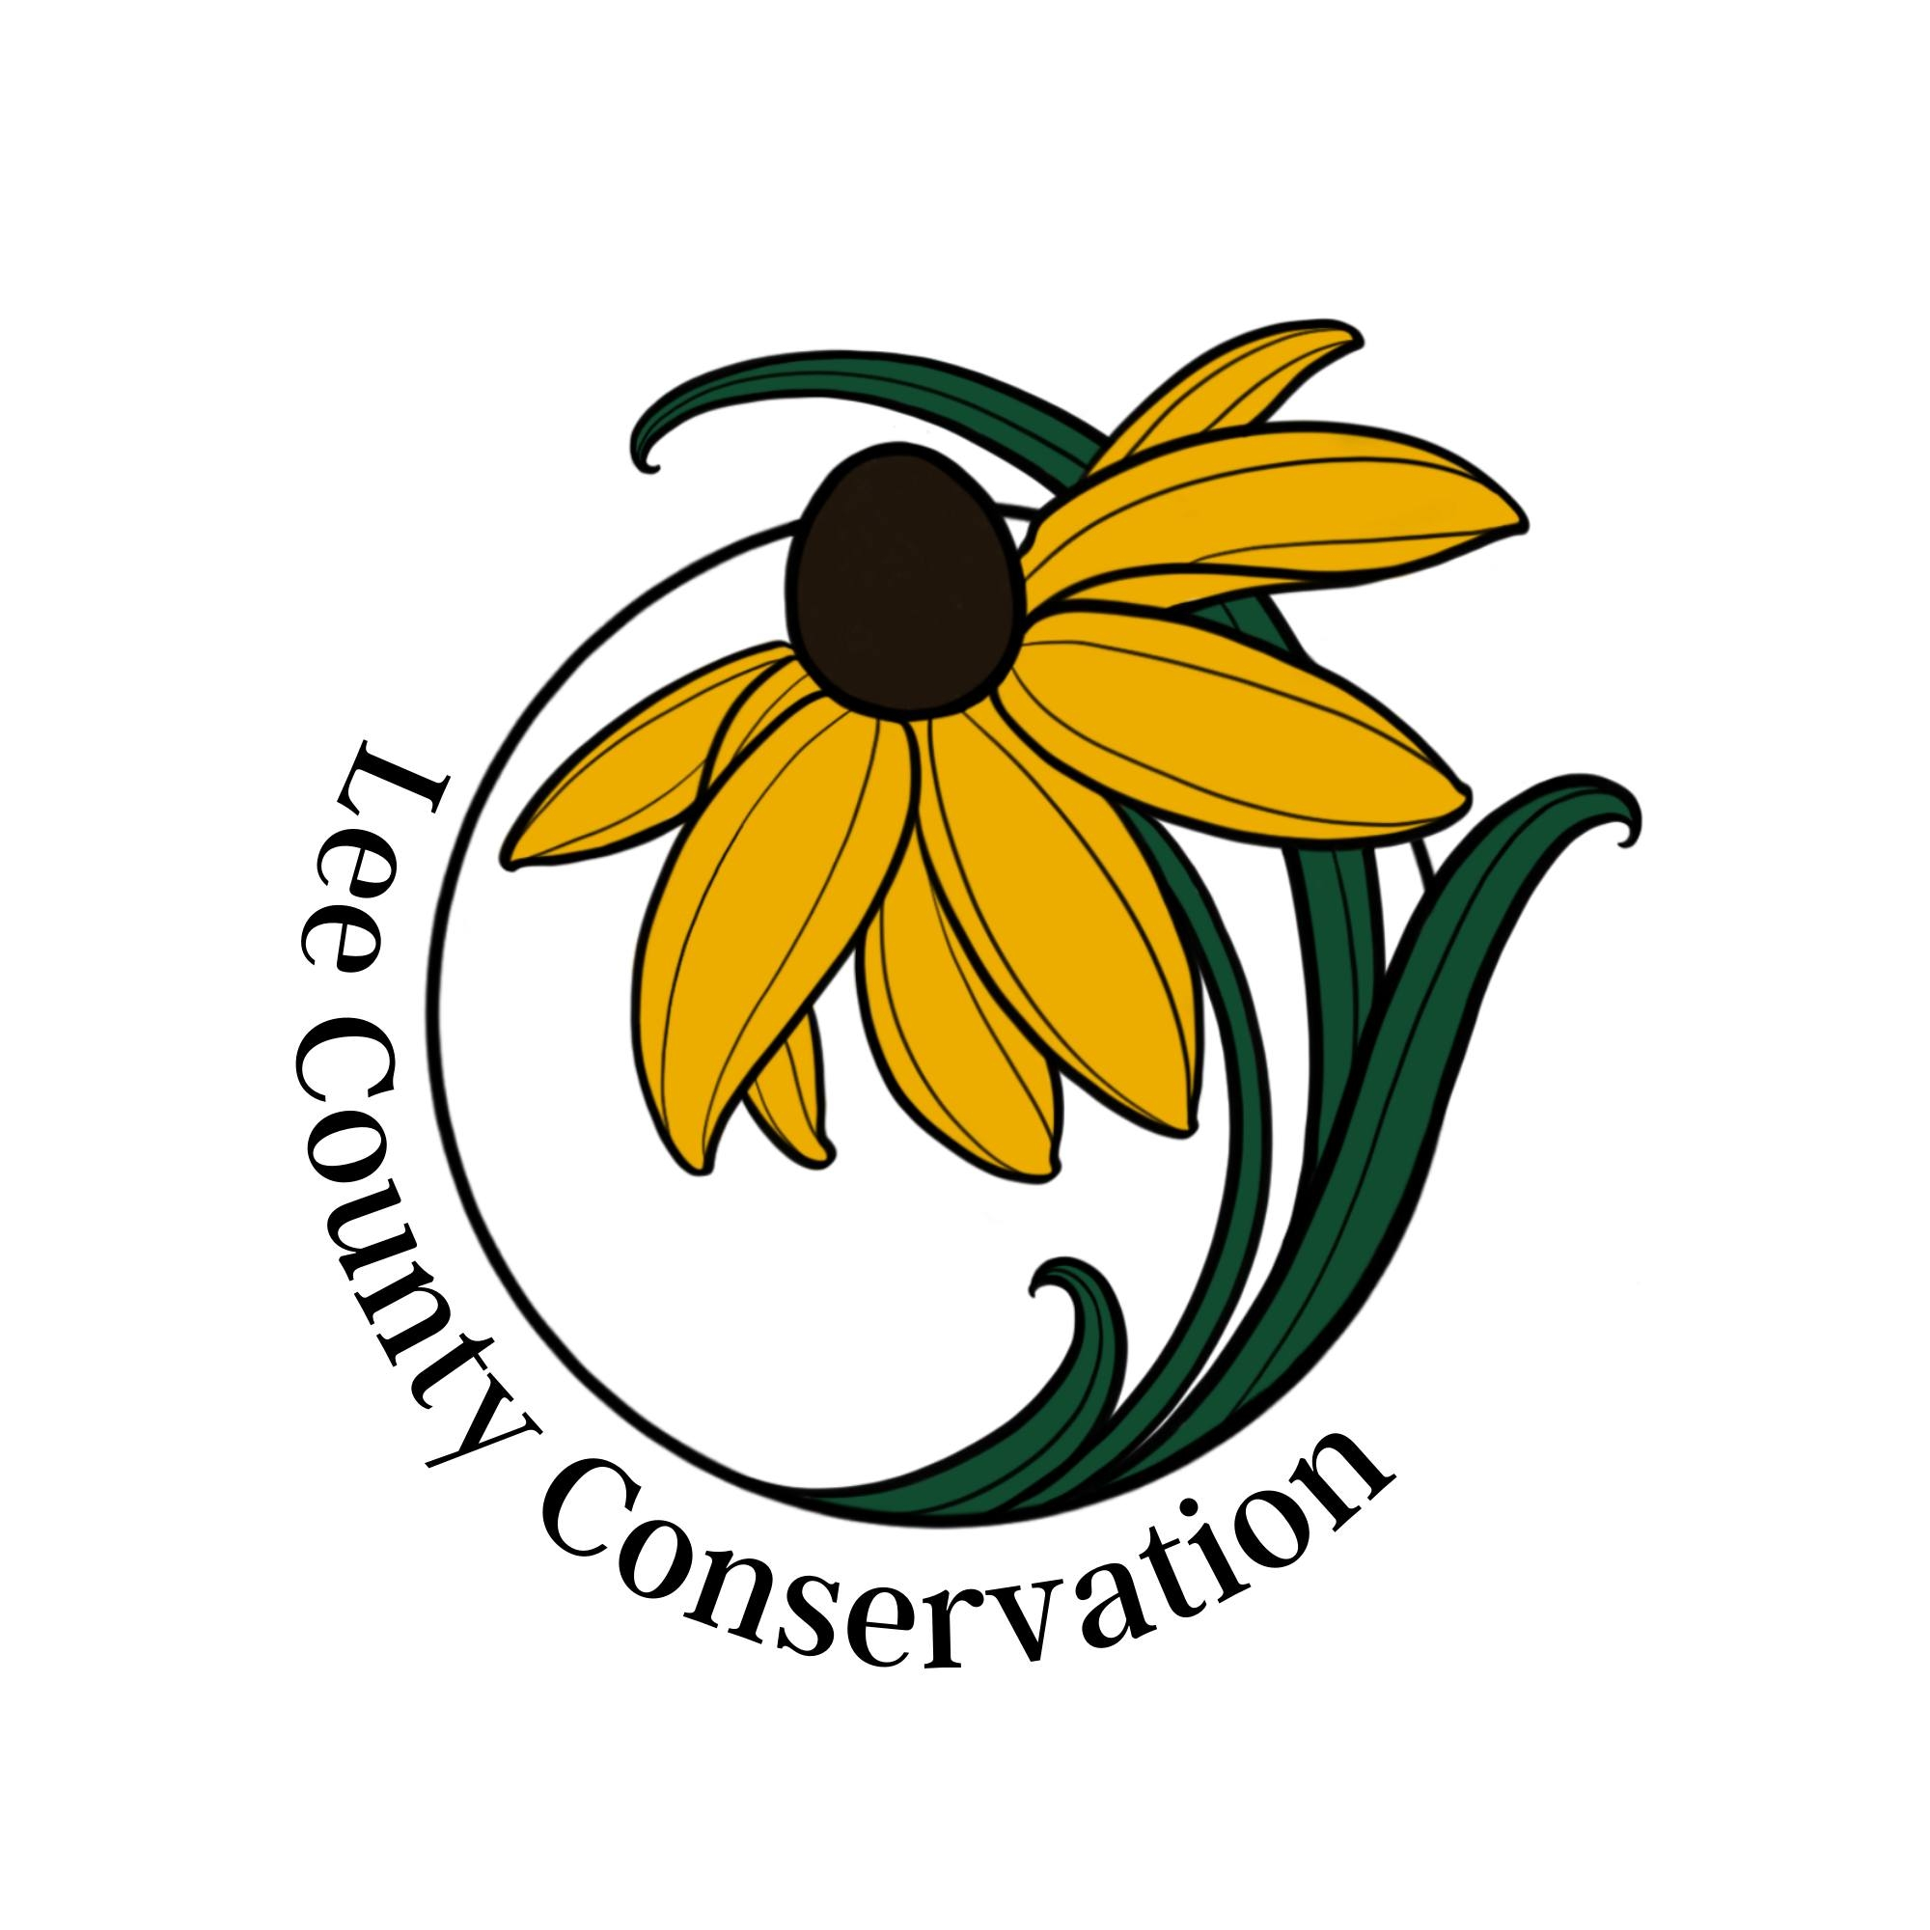
Cooper Island Chain Restoration Project Lee County, IA ( Pool 19)
Upper Mississippi River ( RM 375-381)
Jim Homann
Program Manager
U. S. Army Corps of Engineers
Rock Island District
James.D.Homann@usace.army.mil
Heather Huebner
Director
Lee County Conservation
hhuebner@leecountyiowa.gov
Dr. Anshu Singh
Executive Director, IAPA
Director of Sustainability, Corn Belt Ports
anshu.singh@cornbeltports.com

Slide 15
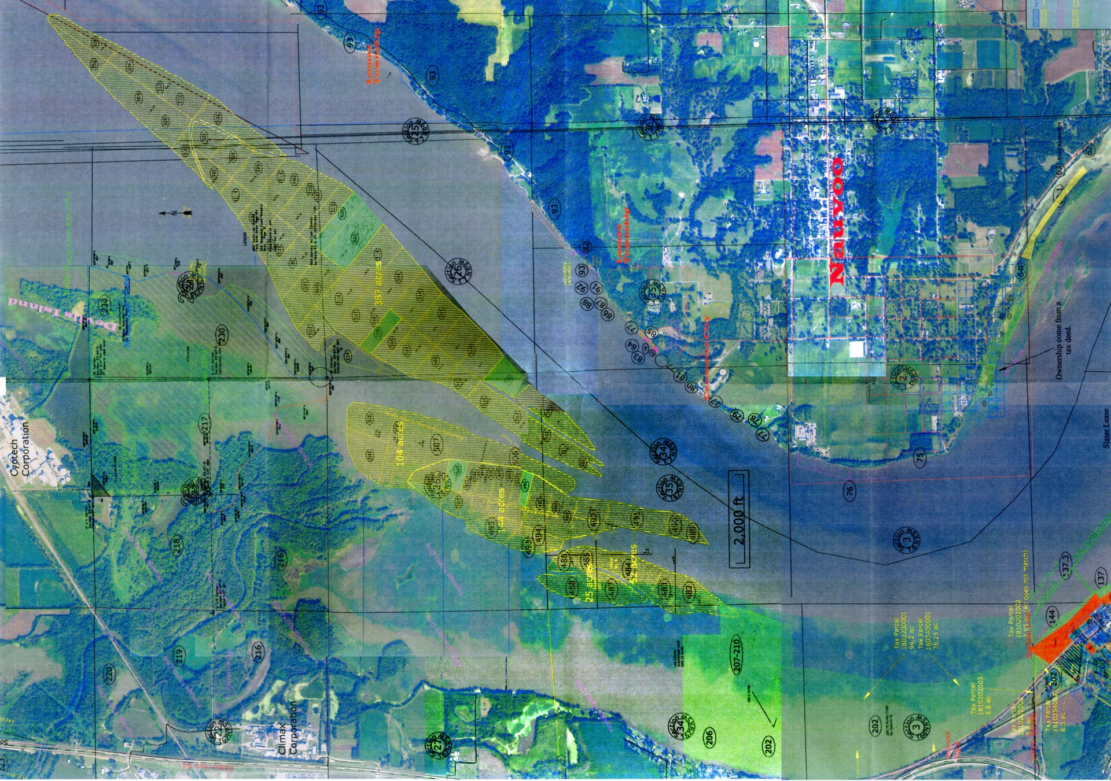
Cooper Island Chain Restoration Project (Pool19)
One of the 29 impounded pools on the Upper Mississippi River
Over 100 years of impoundment has caused ecological erosion
Over time:
Islands have eroded and disappeared
Sediment has filled backwaters and side channels
Water quality has declined
Native plants and wildlife have struggled to survive
Notes:
Erosion and wave action are destroying remaining islands, and sedimentation is reducing water depth and habitat diversity.

Slide 16
Cooper Island Chain
Critical Migratory Pathway
Continentally significant mid-migration resting and feeding area for diving ducks.
Aerial surveys conducted over 75 years show a declining population of diving ducks.
Restoring suitable habitat is critical to maintaining this important migratory flyway and protecting fish and other species.
Notes:
Pool 19 is renowned for diving duck migratory stopovers, concentrations of diverse fish and native mussel populations and a section of river with lush beds of aquatic vegetation needed to support the afore-mentioned faunal groups.
Today, the critical river habitat needed to support Pool 19 plants and animals has declined in large part due over 100 years of impoundment and the lack large-scale river restoration. Protecting the remnants of healthy habitat mosaics and restoring critical habitat components in other areas is essential to support declining populations of resident and migratory species found in Pool 19.

Slide 17
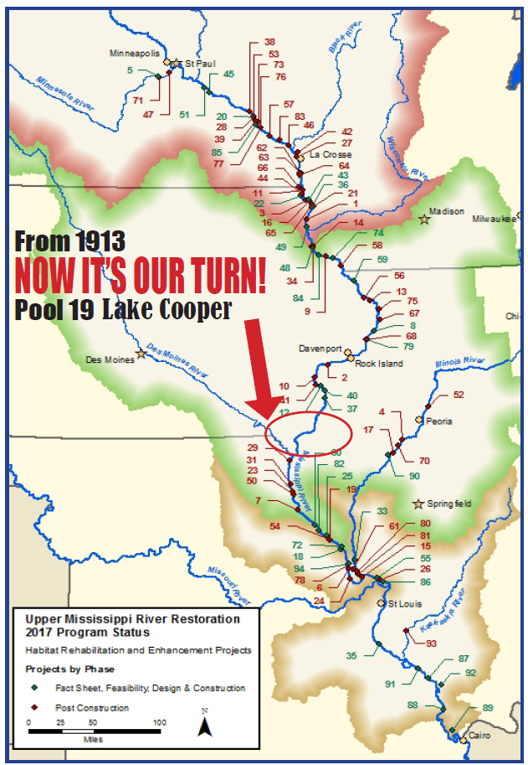
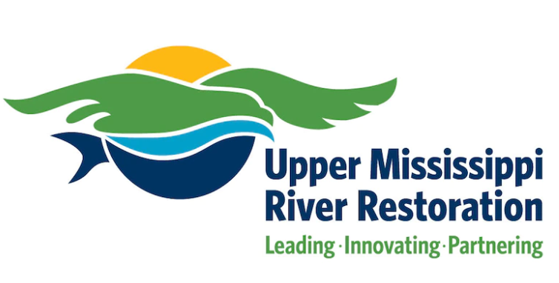
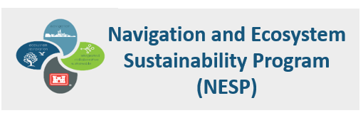
Pool 19- A Forgotten Reach of the Mississippi River
The Upper Mississippi River System (UMRS) was recognized in 1986 by Congress as a “nationally significant ecosystem”.
Over 60 large scale habitat projects have been completed in the UMR through the UMRR program and none of the projects are in Pool 19. We need to break this cycle.
Notes:
This is a Call to Action for the Upper Mississippi River (UMR) Pool 19. As large-scale river restoration has been underway on the entire system of UMR since 1987. Every pool has had some form of ecological restoration project constructed, except Pool 19. As the Pool 19 dam was built by the power company for hydropower, the land is in the private ownership of the power company or individuals, and none of the land is federally owned. Implementing restoration actions on these private lands is almost impossible due to federal restrictions.
Federal guidelines for programs such as the Upper Mississippi River Restoration (UMRR) and the Navigation and Ecosystem Sustainability Program (NESP) require all restoration activities occur on federal lands typically at 100% federal cost or on state lands or non-profit lands with a cost share that varies between 25-35%.

Slide 18
Cooper Island Chain Restoration
Time to Act
Rare Opportunity- Ready-to-Implement project with Approved Feasibility Report
Section 204, Beneficially Use of Dredged Material (BUDMAT) Project
Project Feature and Benefits
Restore 14 acres of island habitat
Use 30,000 CY of beneficial dredged material
Two island restoration areas: IS-3 (8 acres) and BW-1 (6 acres)
Construct 3 rock chevrons to reduce erosion and improve flow
Support aquatic vegetation and improve water clarity
Enhance habitat for fish, birds, and pollinators
Notes:
Enhanced habitat for indigenous fish, migratory birds, and terrestrial wildlife by restoring breeding, stopover, nesting, and foraging habitat
Improved overwintering habitat for fish
Improved water quality

Slide 19
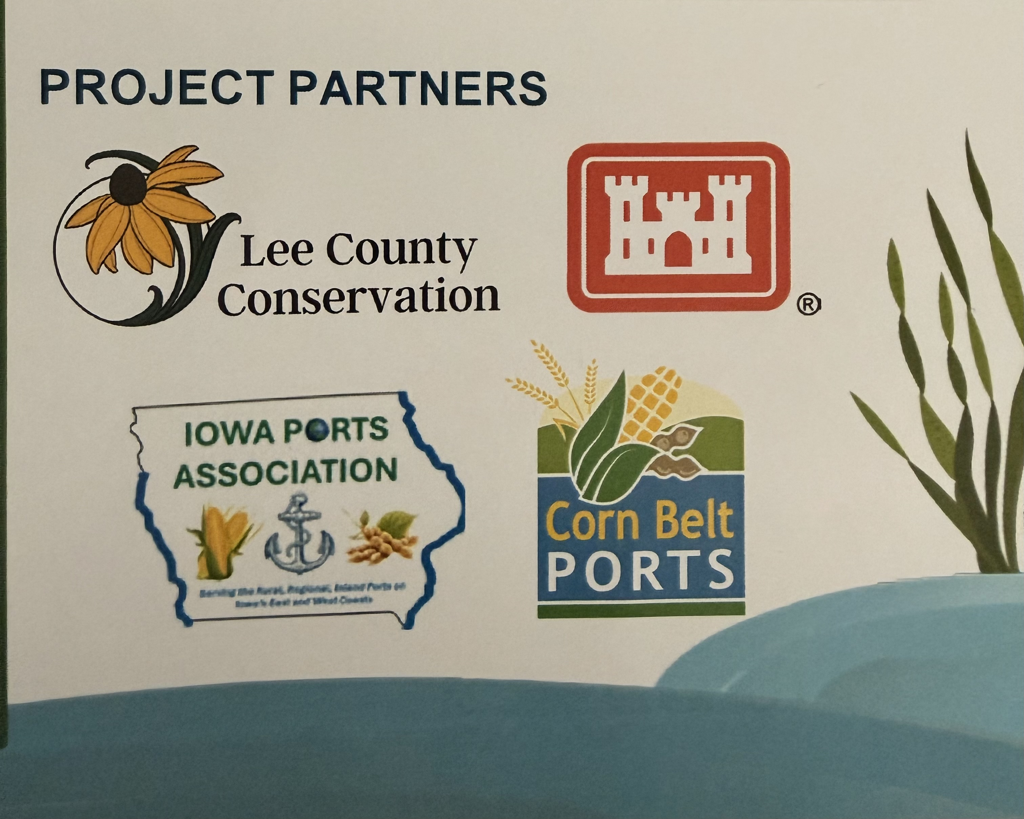
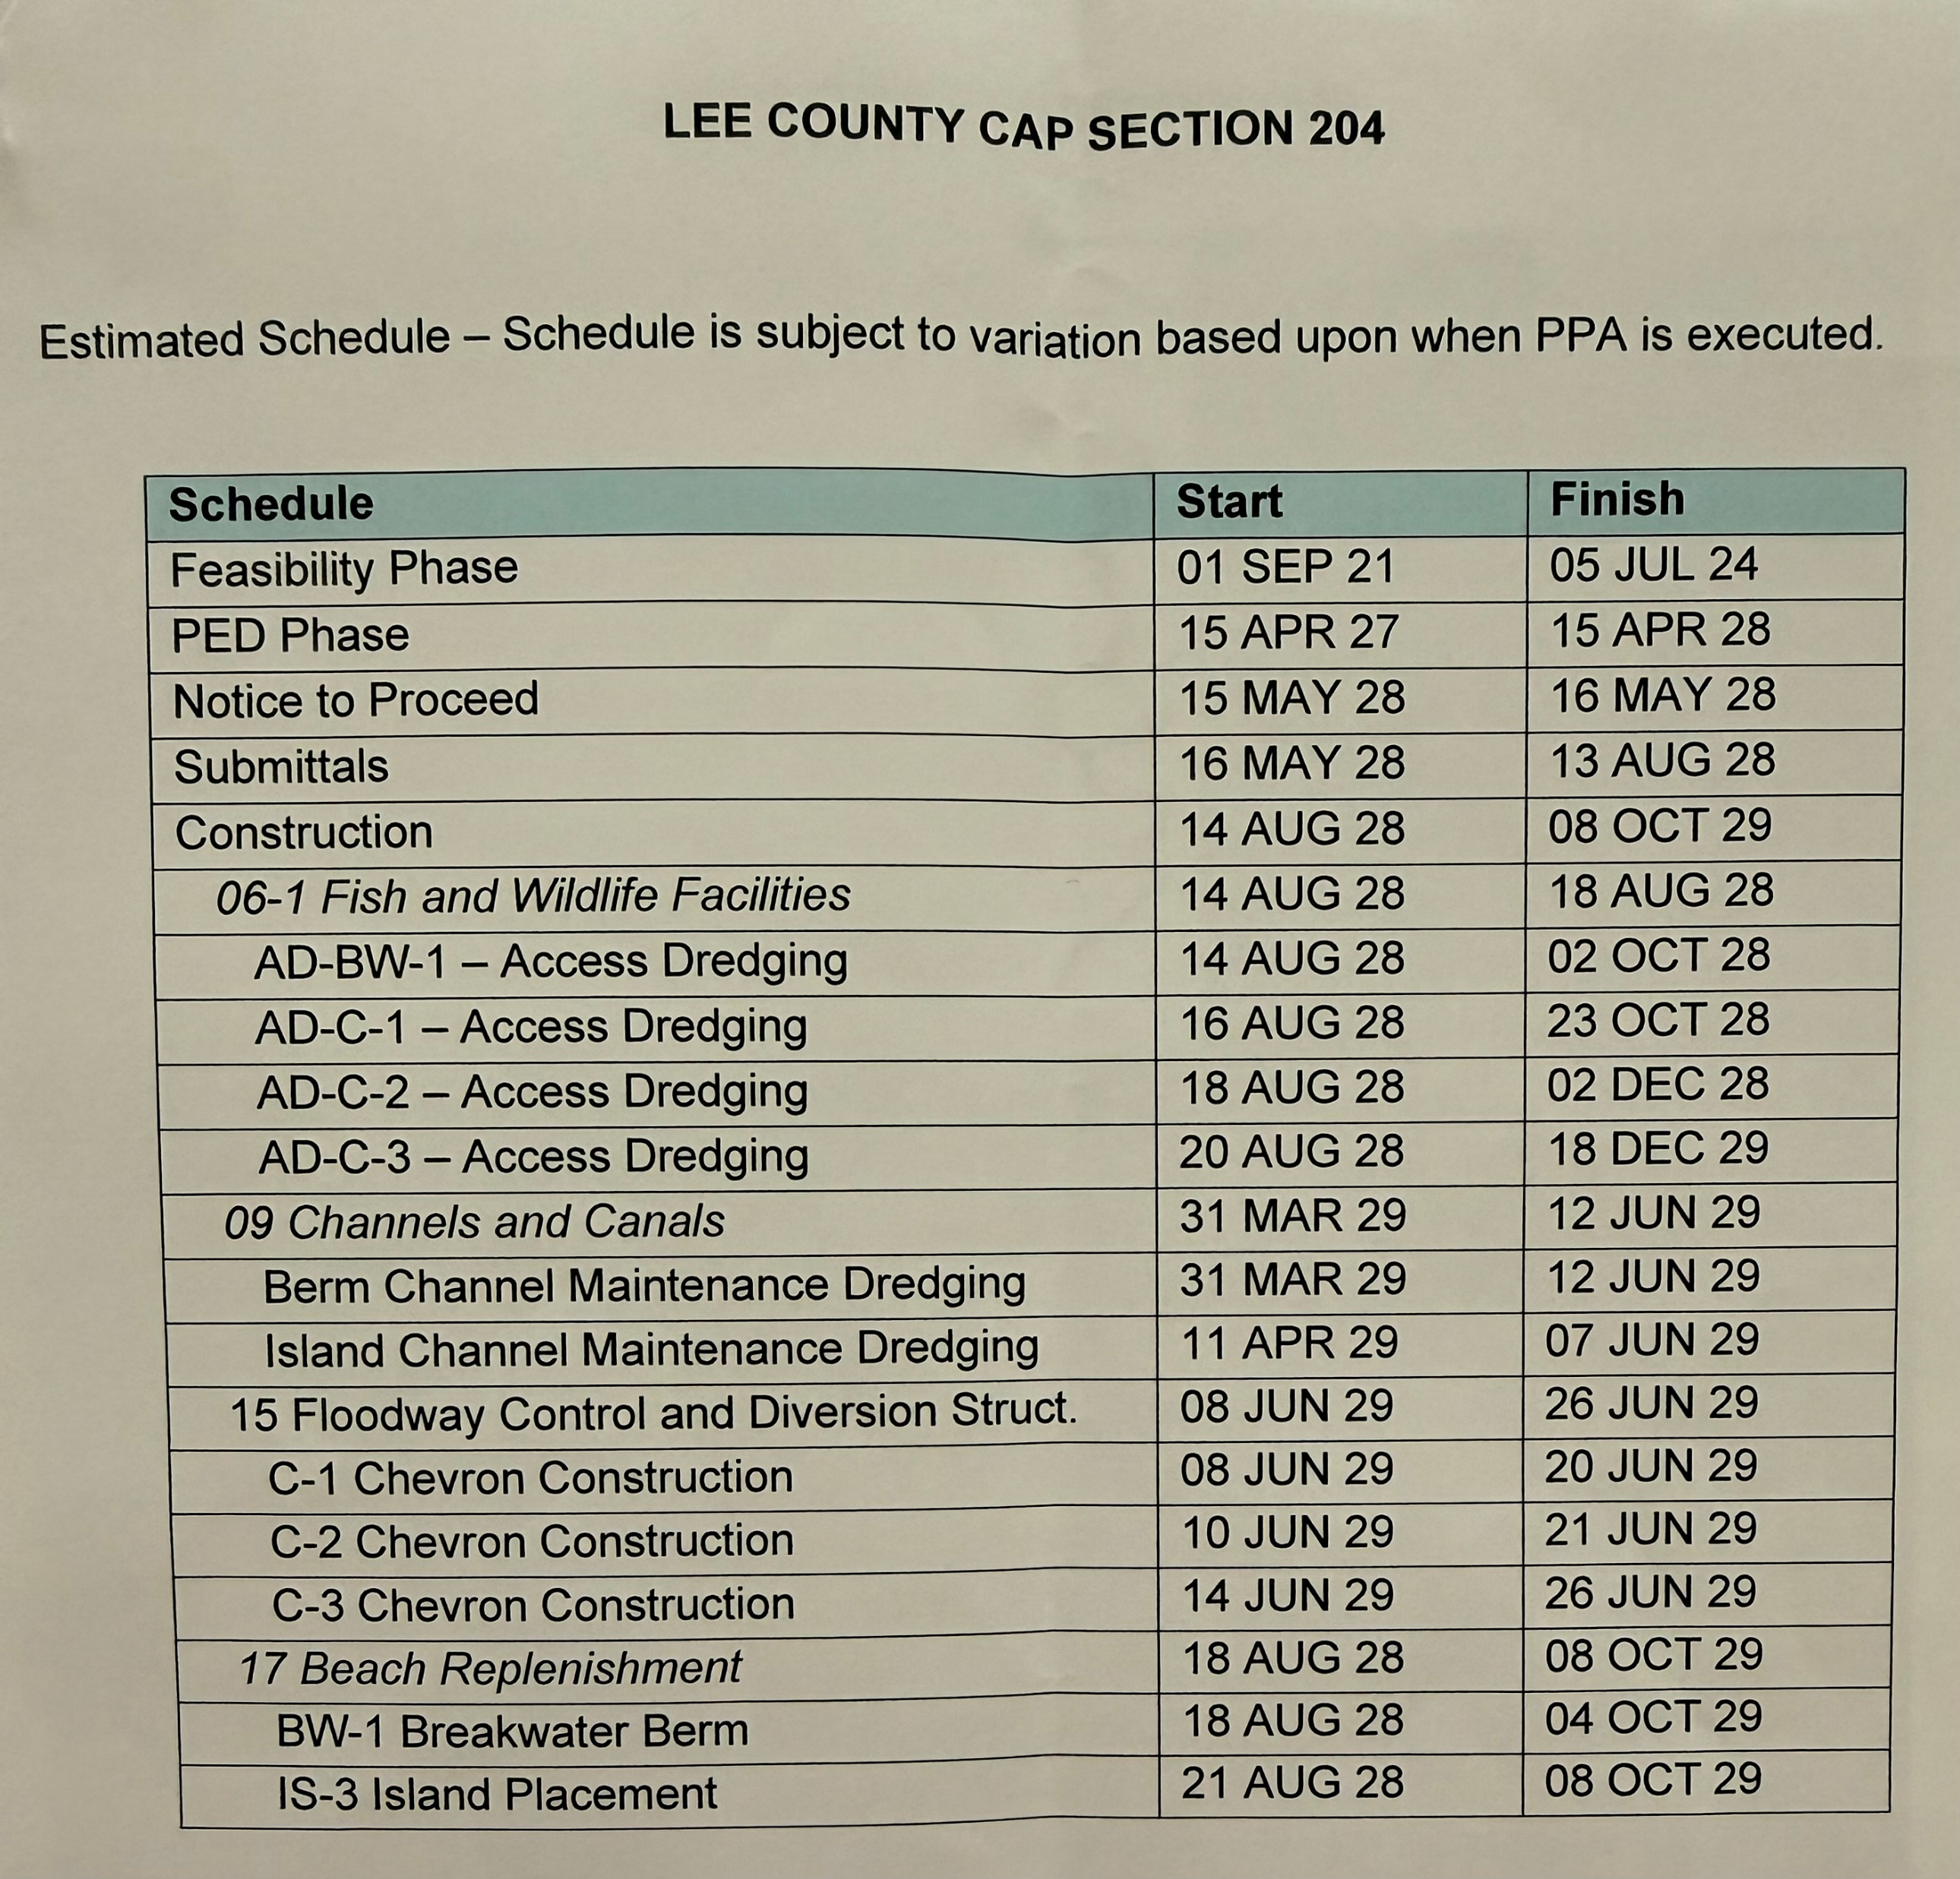
Help Bring the Cooper Island Chain Restoration Project to Reality
Your investment will help secure federal funding and move this nationally significant ecosystem restoration project into construction.
Total Project Cost: $8 Million
Local Non-Federal Match Required: $2.5 Million
Groundbreaking Target: August 2028
Project Completion & Ribbon Cutting: October 2029

Slide 20
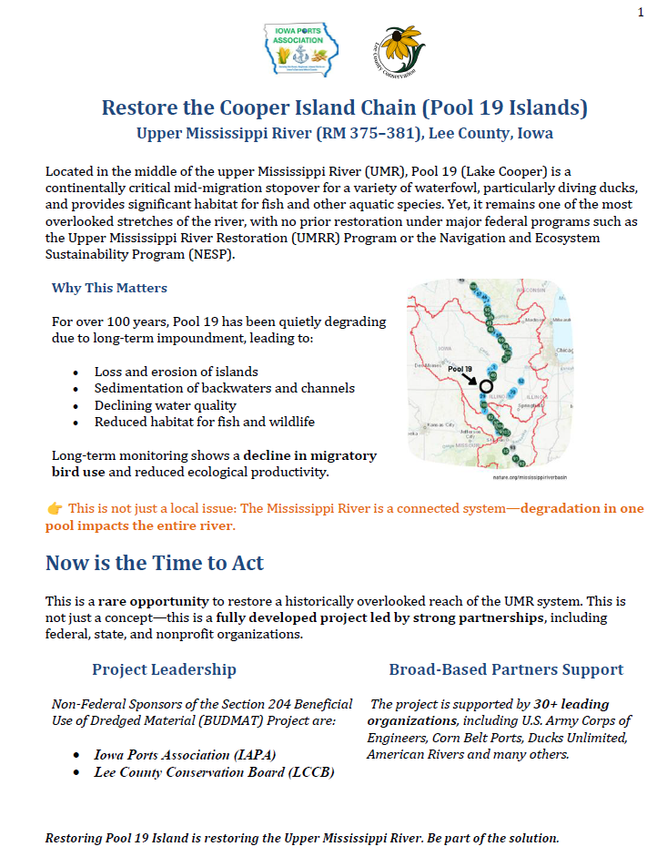
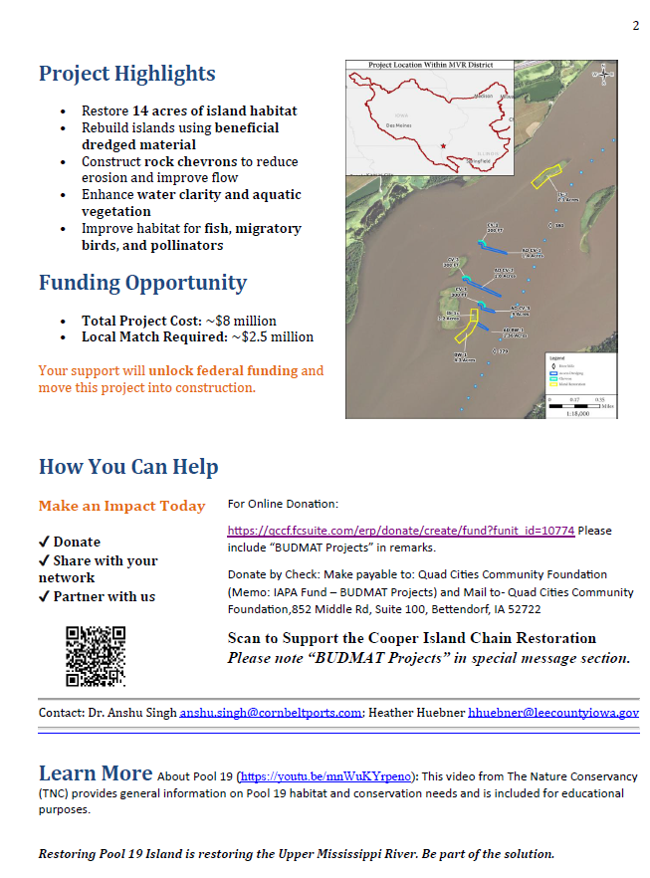

Slide 21
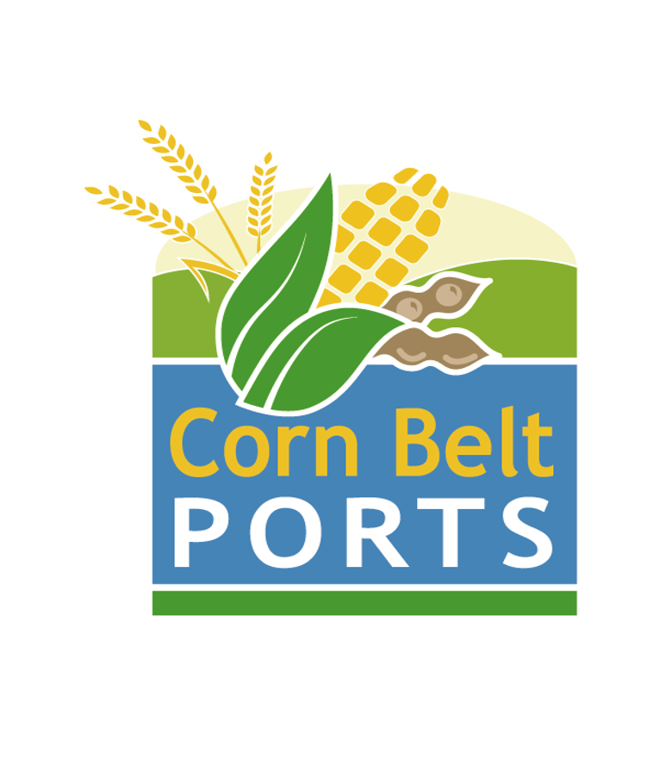
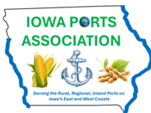
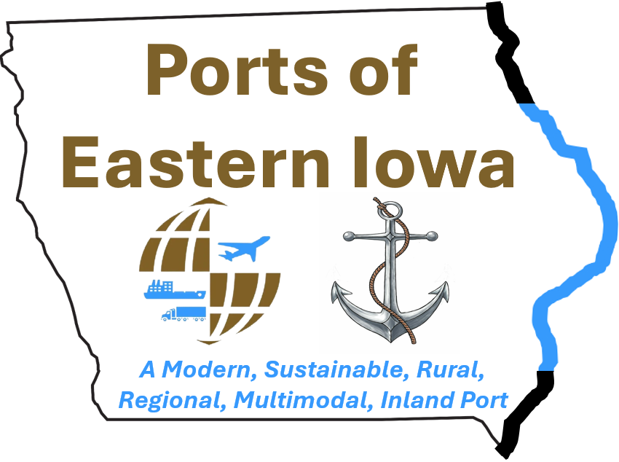

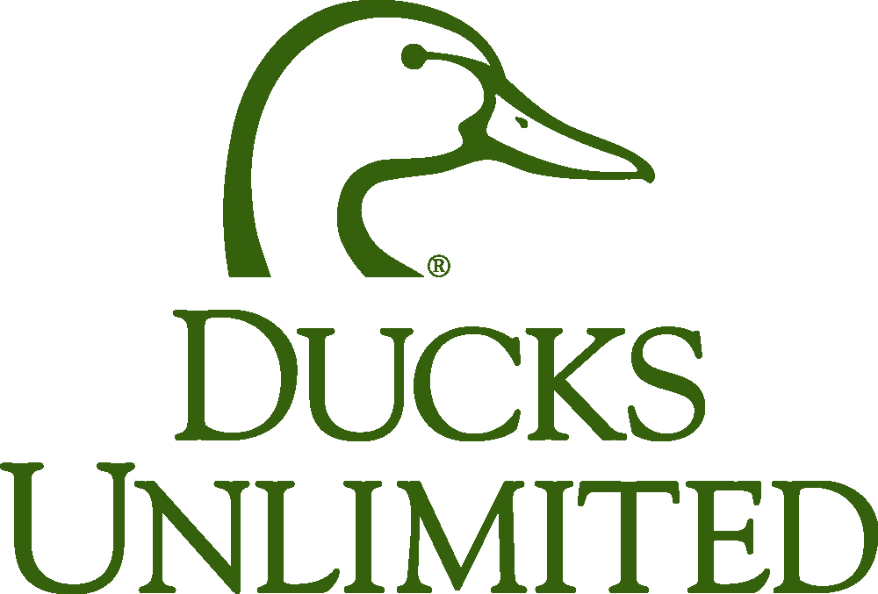

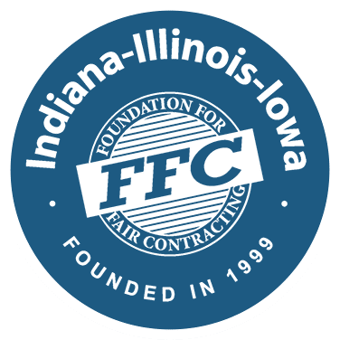






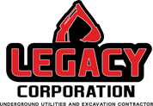

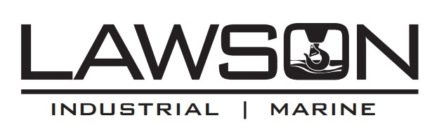
Partners and Supporters
Restore the Cooper Island Chain (Pool 19 Islands)
Upper Mississippi River (RM 375–381), Lee County, Iowa

Slide 22
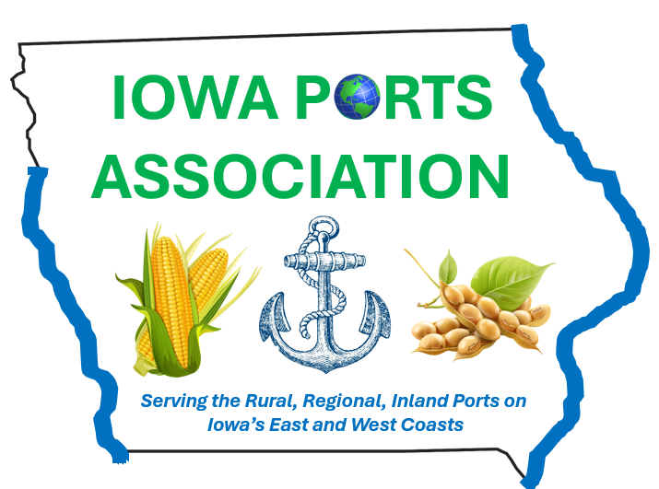

Dr. Anshu Singh
Executive Director
Iowa Ports Association
anshu.singh@cornbeltports.com

Slide 23
Aquatic Ecosystem Restoration in Lee County, IA Section 204 Project
Feasibility Report with Integrated Environmental Assessment- approved in Feb 2025
Project Partnership Agreement (PPA) between USACE, Rock Island District and Lee County Conservation Board and Iowa Ports Association (Non-Federal Sponsors)- in progress

Slide 24
Project Features and Benefits
Beneficially use 30,000 CY of dredged material
Two island restoration areas: IS-3 (8 acres) and BW-1 (6 acres including breakwater function)
Three rock chevron structures to enhance bathymetric diversity and reduce wave action
Access dredging: Approximately 59,000 cubic yards beneficially reused
Enhanced habitat for indigenous fish, migratory birds, and terrestrial wildlife by restoring breeding, stopover, nesting, and foraging habitat
Improved overwintering habitat for fish
Improved water quality

