Slide 1
2026 Corn Belt Ports & Mid-America Port Commission Annual Meeting rock island district update
Col. Aaron Williams
District Commander
Date: 30 July 2026

Slide 2
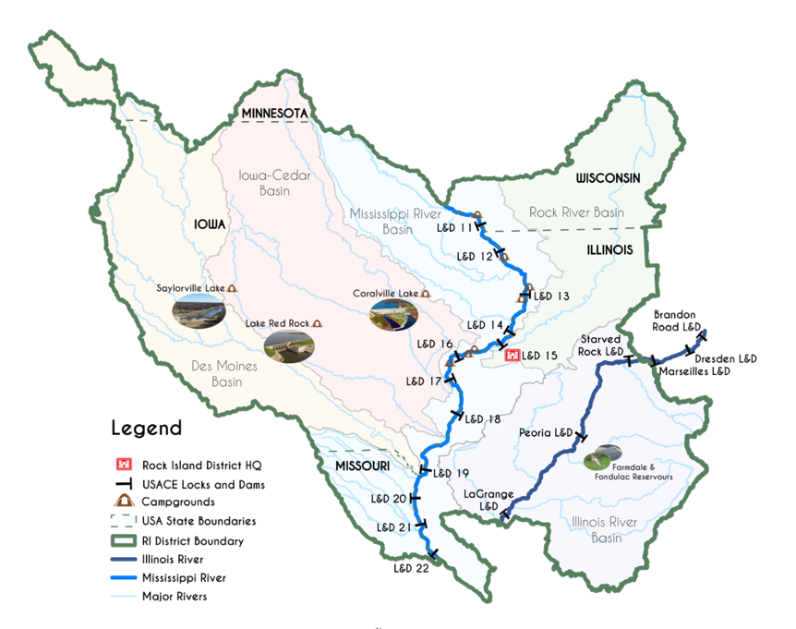
Rock Island District
Area of Responsibility
Portions of 5 river basins:
  Mississippi River
  Illinois River
  Des Moines River
  Iowa-Cedar River
  Rock River
18 Lock & Dam Sites​
2 Authorized Navigation Projects​
525 mi. of Navigable River
  ILWW - 211 river miles
  UMR - 314 river miles
12 Small Boat Harbors
5 Flood Risk Management Projects
Roughly 78,000 sq. miles in portions of:
  Iowa
  Illinois
  Wisconsin
  Minnesota
  Missouri

Slide 3
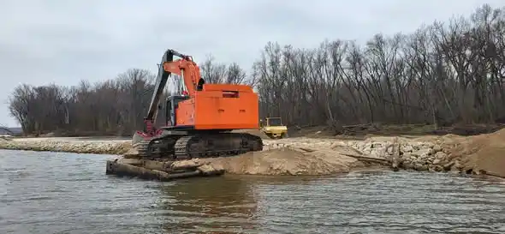
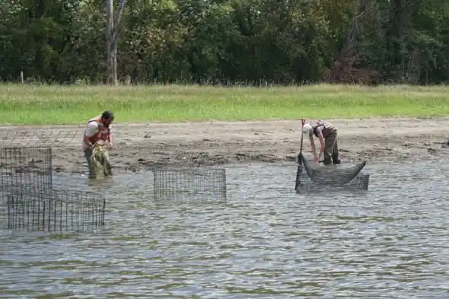
Upper Mississippi River Restoration (UMRR) Program
Collaboration between Operations Division & UMRR program
Steamboat Island Habitat Rehabilitation & Enhancement Project
USACE, USFWS, & IA DOT Collaboration at Huron Island Habitat Rehabilitation & Enhancement Project

Slide 4
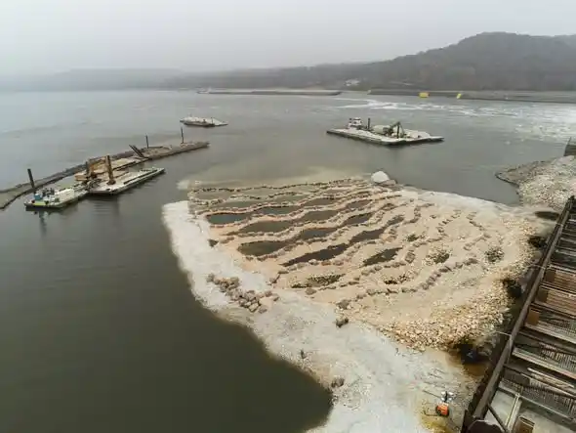
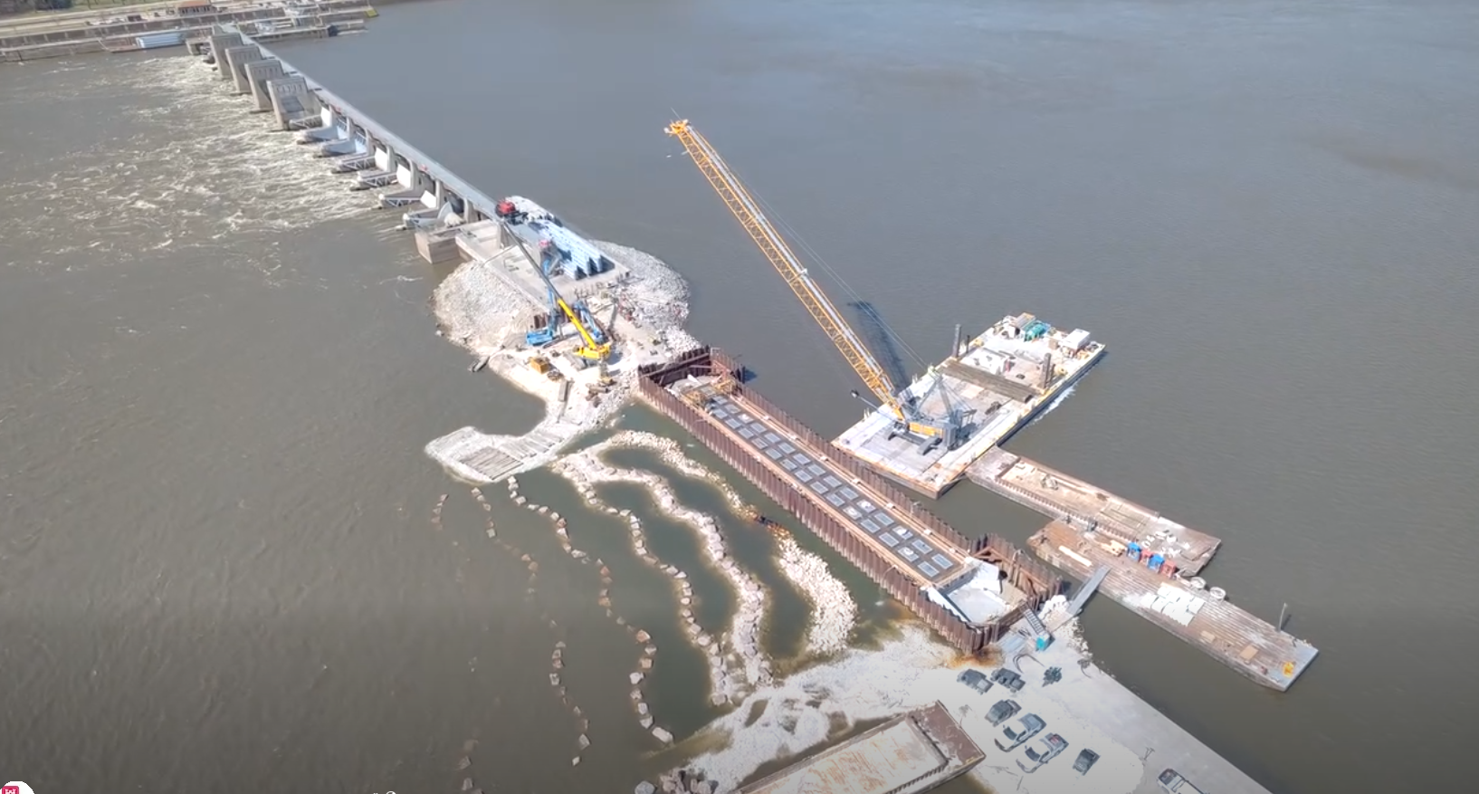
Navigation & Ecosystem Sustainability Program (NESP)
L&D 22 Fish Passage Project

Slide 5
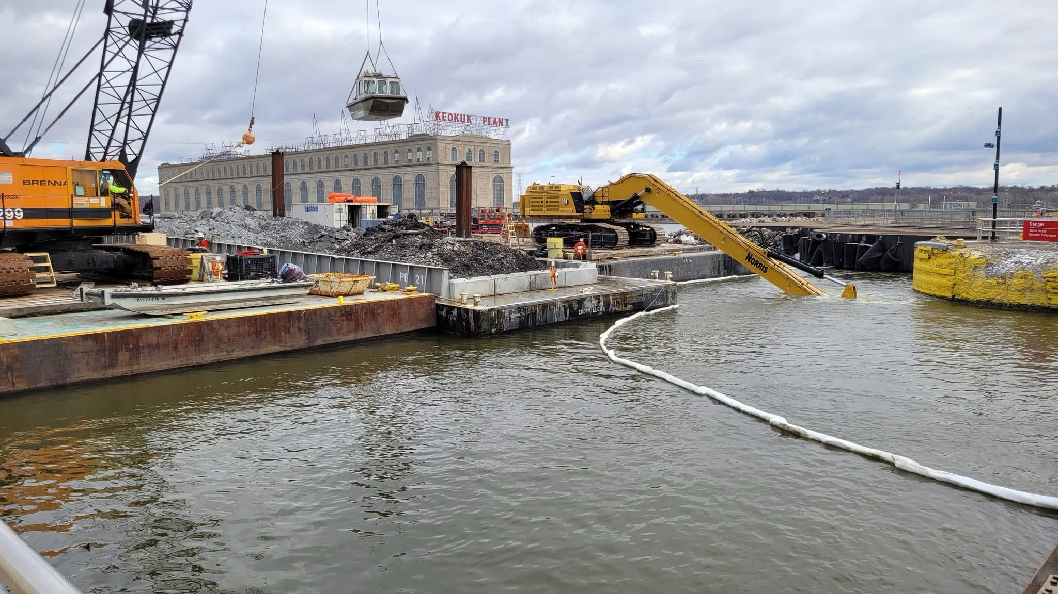
Rock Island District Operations
Maintenance at L&D 19

Slide 6
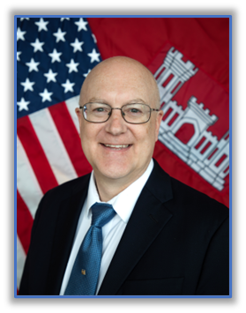
2026 Corn Belt Ports & Mid-America Port Commission Annual Meeting navigation update
Thomas Heinold
Chief, Operations Division
Date: 30 July 2026

Slide 7
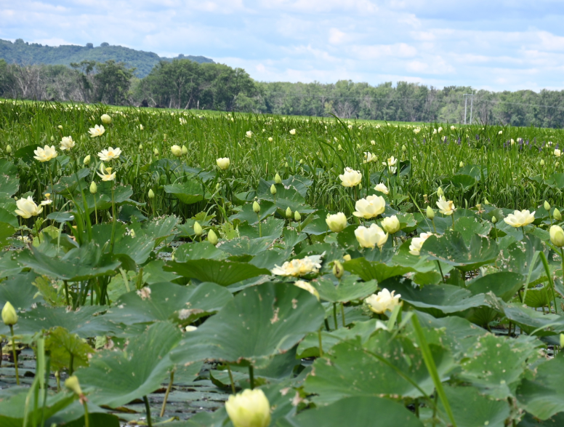
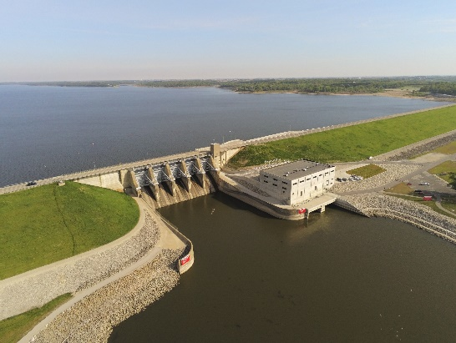
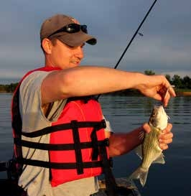
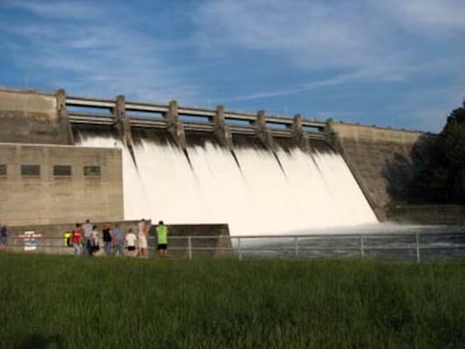
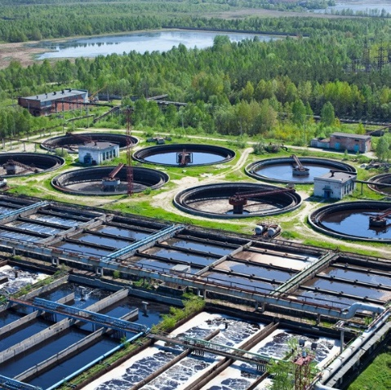
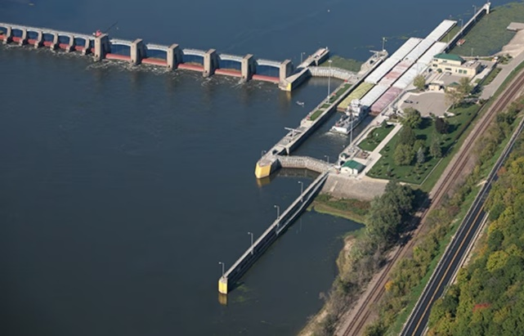
Who We Are: Building and Maintaining Network of Water Infrastructure
Environmental Stewardship
Recreation
Flood Risk Management
Water Supply
Navigation
Hydropower

Slide 8
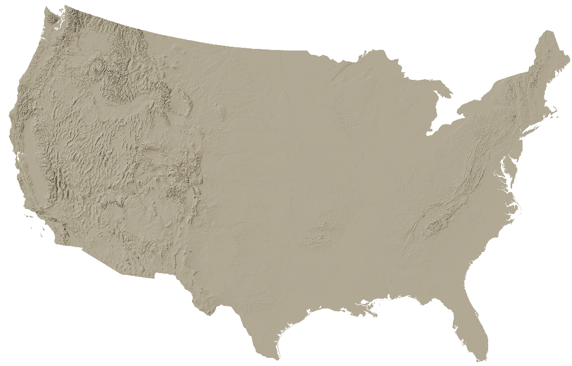
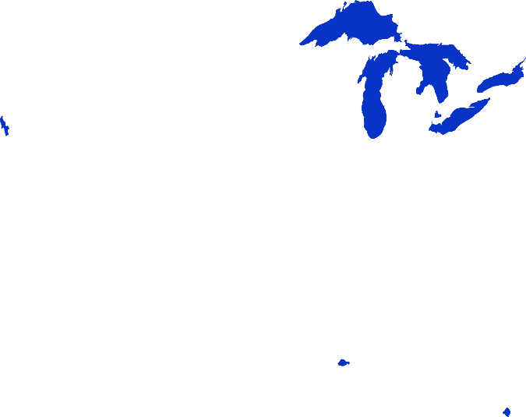
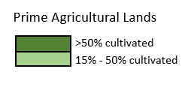
Our Geographical Advantage
“The Center Coast”

Slide 9
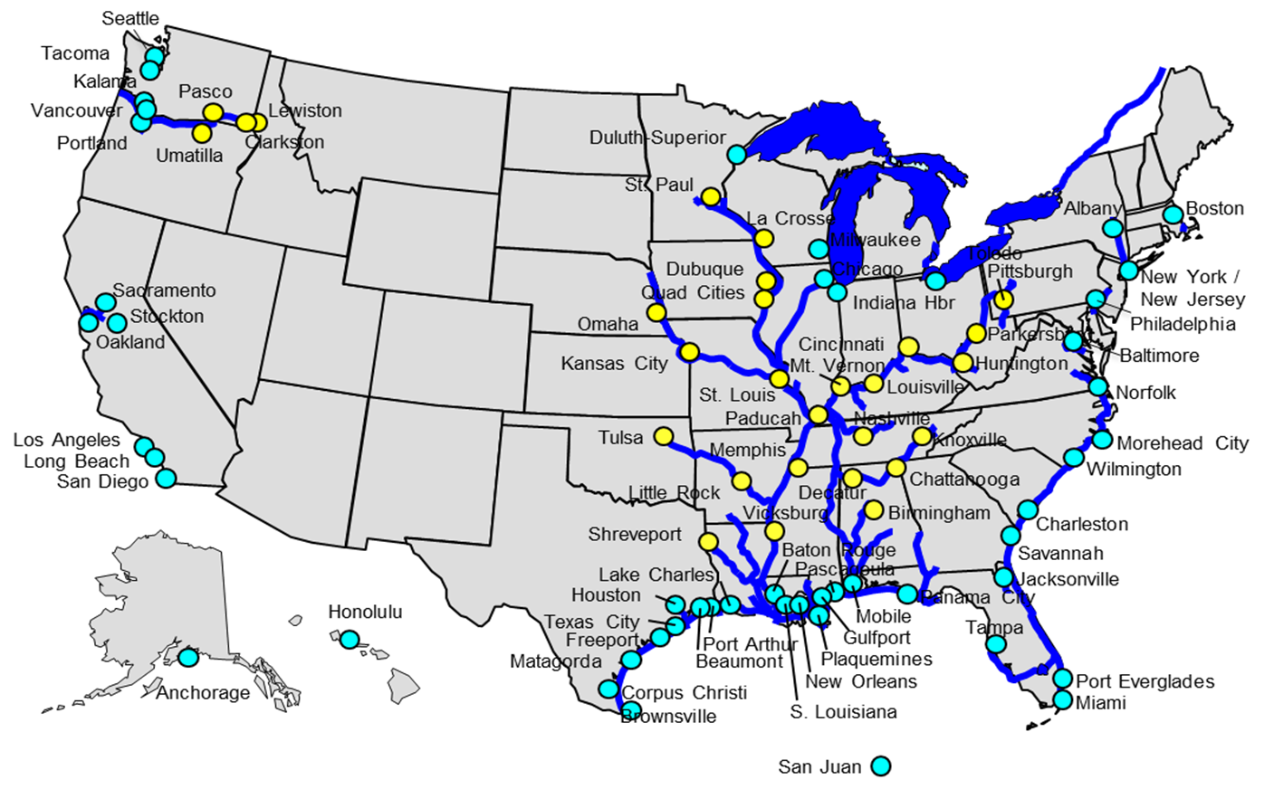
USACE Navigation System
U.S. Marine Transportation Industry Supports
~ $2 Trillion in Commerce Annually
More than 48% of Consumer Goods Bought by Americans Pass Through Harbors Maintained by Corps.
Over 1.6 Billion Short Tons of Foreign Goods Moved Through U.S. Ports/Waterways in 2022
Over 760 Million Short Tons of Domestic Goods Moved Thru U.S. Ports/Waterways in 2022
15% of U.S. Domestic Freight Carried by Water
237 Lock Chambers at 192 sites
13,000 Miles of Coastal and Deep Draft Channels
12,000 Miles of Commercial Inland and Intracoastal Waterways
1,072 Coastal, Great Lakes and Inland Harbors
45 States are directly served by USACE Channels & Waterways
Annual O&M costs of $3.5 - $4B

Slide 10
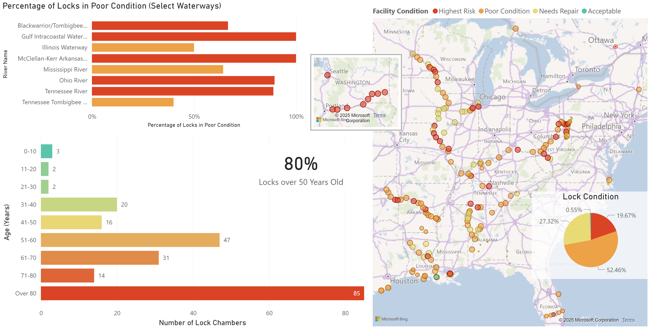
Infrastructure Condition

Slide 11
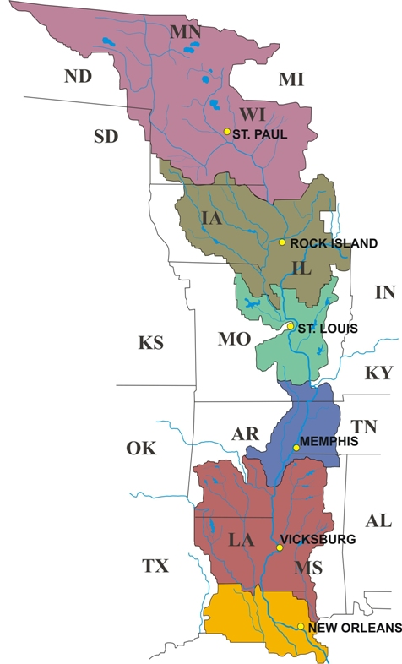
Maintaining Reliability Requires Investment
MVD Backlog as of February 2026: $7.5B
MVR Backlog as of February 2026: $3.7B

Slide 12
NAV Funding (Rock Island District)
>$3B Backlog of Maintenance
Spikes in ’19-’20 & ’22-’23 for IWW Consolidated Closures
Avg. ~$150M/year, most of which goes to routine O&M
At $250M/year, it would take 30+ years to erase the backlog
We could handle $400M/year, erase the backlog in a dozen years and then reduce back to a maintainable level

Slide 13
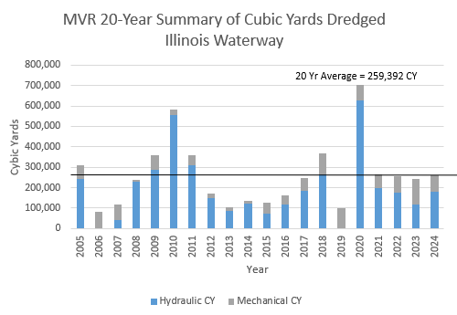
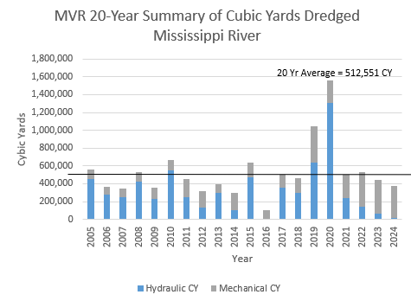
Rock Island District
Channel Maintenance
FY25 Dredging (Below 20-year averages)
  IWW – 10 Locations totaling 200,000 CY
  UMR – 23 Locations totaling 300,000 CY

Slide 14
Operations & Maintenance
Navigation
Overall Funding
Routine baseline O&M funding adequate for FY26
Only one non-routine package to address backlog was funded in FY26 (Dam gates at Dam 22, $18M)
Dam gate recapitalization program is beginning
Overall Staffing
We were recently authorized to hire lock operators and other key maintenance personnel.

Slide 15
Operations & Maintenance
Illinois Waterway
Projects
Peoria/LaGrange Dams three-wicket bulkhead delivered and in use
Peoria/LaGrange Dams end-of-dam/wicket bulkhead fabrication ongoing
Lagrange Tainter valve line boring and pin replacement complete
Brandon Road Tainter gate piers repairs ongoing
Lock Availability
Rock Island District’s IWW locks should remain open for the coming season with only short intermittent closures for valve repairs
Lockport Lock upper lift gates replacement (complete)
Peoria/Lagrange FRP wicket fabrication (completed 247 wickets)

Slide 16
Operations & Maintenance
Mississippi River
Projects
Lock 19 Nose Pier Repair (FY25 award)
Dam 21 Tainter Gate Replacement (FY25 award)
Dam 22 Tainter Gate Replacement (FY22 award + FY26 award)
Dam Bulkhead Lifter Crane Replacement – 4 sites (FY23 award)
Lock 16 Tainter Valve Replacement (one set / FRP demonstration, FY25 award)
Lock Availability
Main commercial locks are staffed normally 24/7
No closures anticipated in the foreseeable future (previously scheduled Lock 19 dewatering deferred until funded)

Slide 17
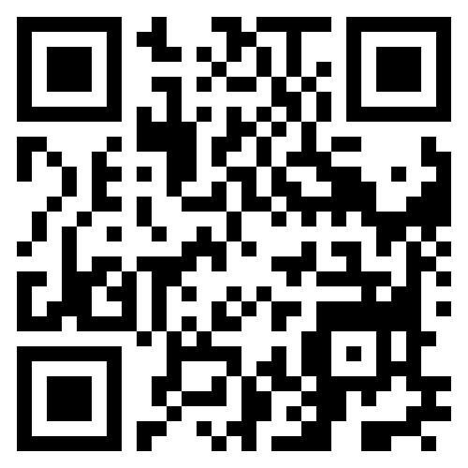

Learn More
Tom Heinold
Chief, Operations Division
Rock Island District
thomas.d.heinold@usace.army.mil
USACE
Homepage
USACE
Civil Works Navigation
https://www.usace.army.mil/
https://www.usace.army.mil/Missions/Civil-Works/Navigation/

Slide 18
2026 Corn Belt Ports & Mid-America Port Commission Annual Meeting
Marshall Plumley
Regional Program Manager,
Upper Mississippi River Restoration
Program (UMRR)
Navigation and Ecosystem Sustainability Program (NESP)
Date: 30 July 2026

Slide 19
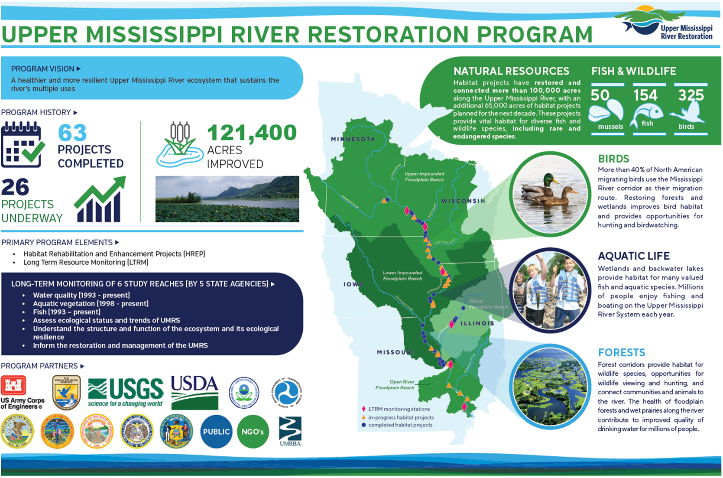

Slide 20

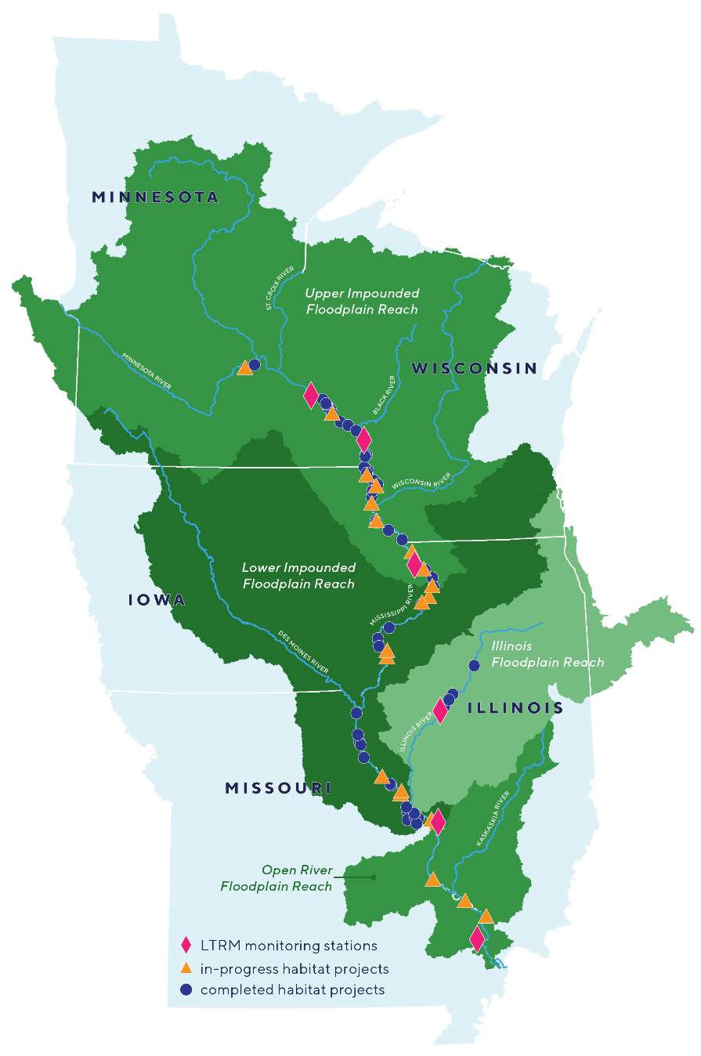
Investment:
1986 – 2025
    12 Completed Projects
    27,870 Acres
2025 – 2035
    5 Projects in Planning, Design, and Construction
    8,499 Acres
Long Term Resource Monitoring
    Need for more information in Pools 14 to 25 & possible approaches
        Partnerships with other efforts collecting data
        Synthesis of existing data
        Additional staff at existing field stations
        A new field station
20

Slide 21
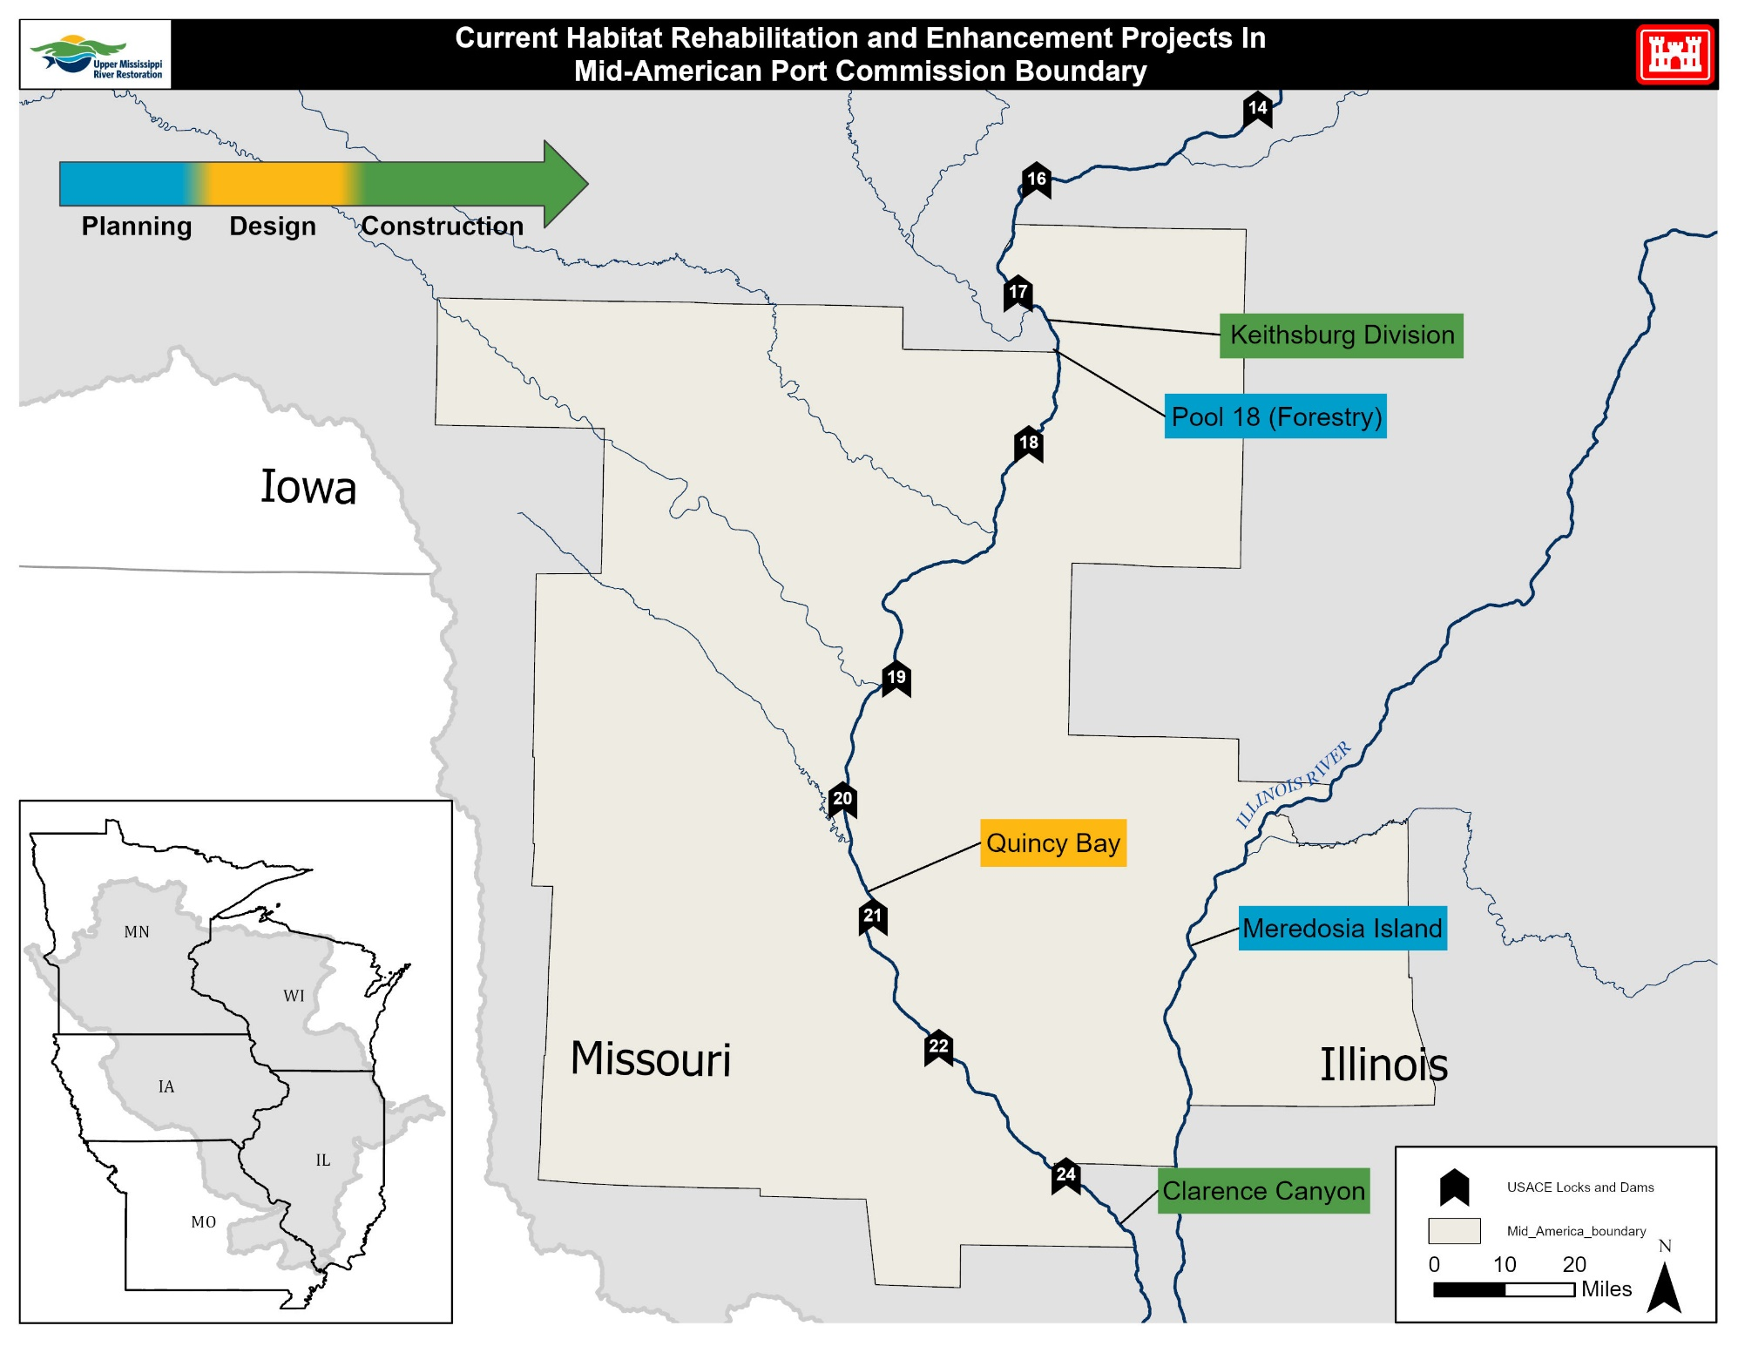

2026

Slide 22
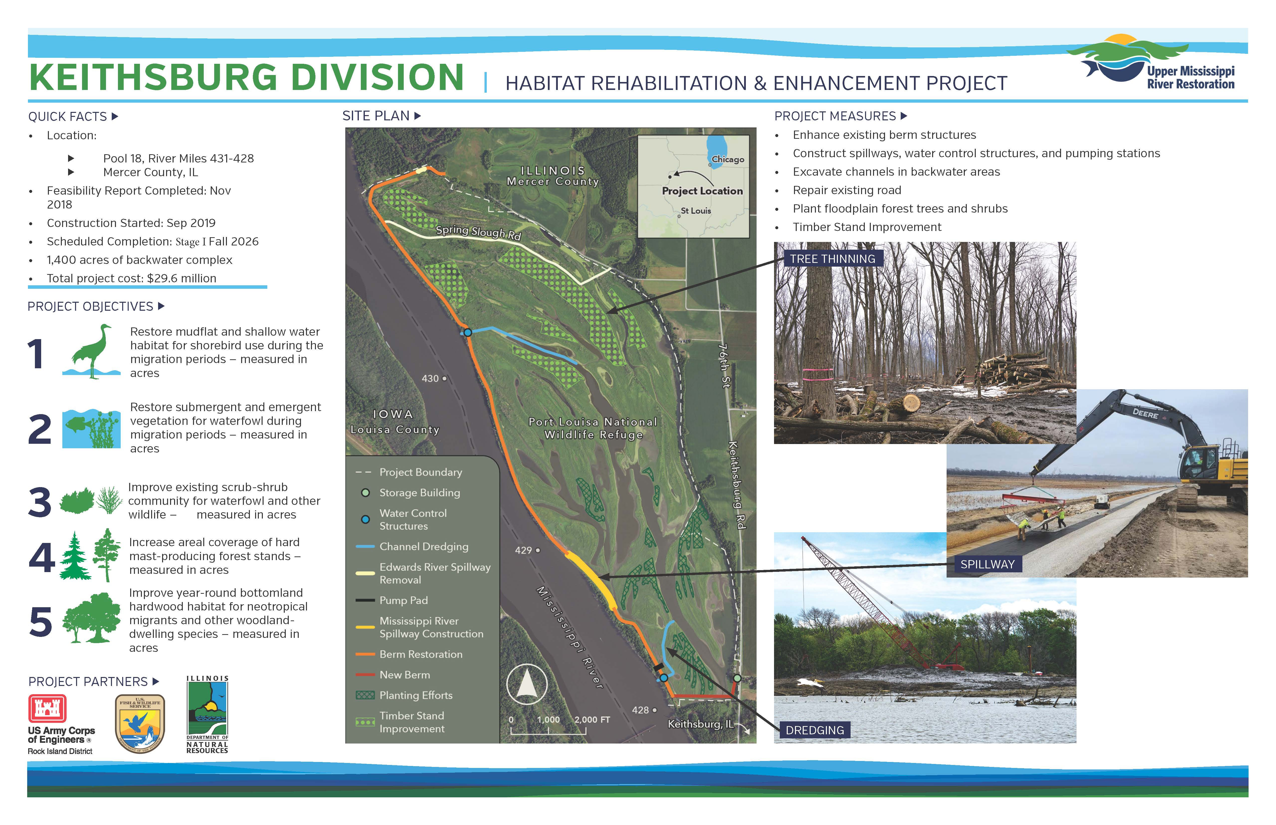
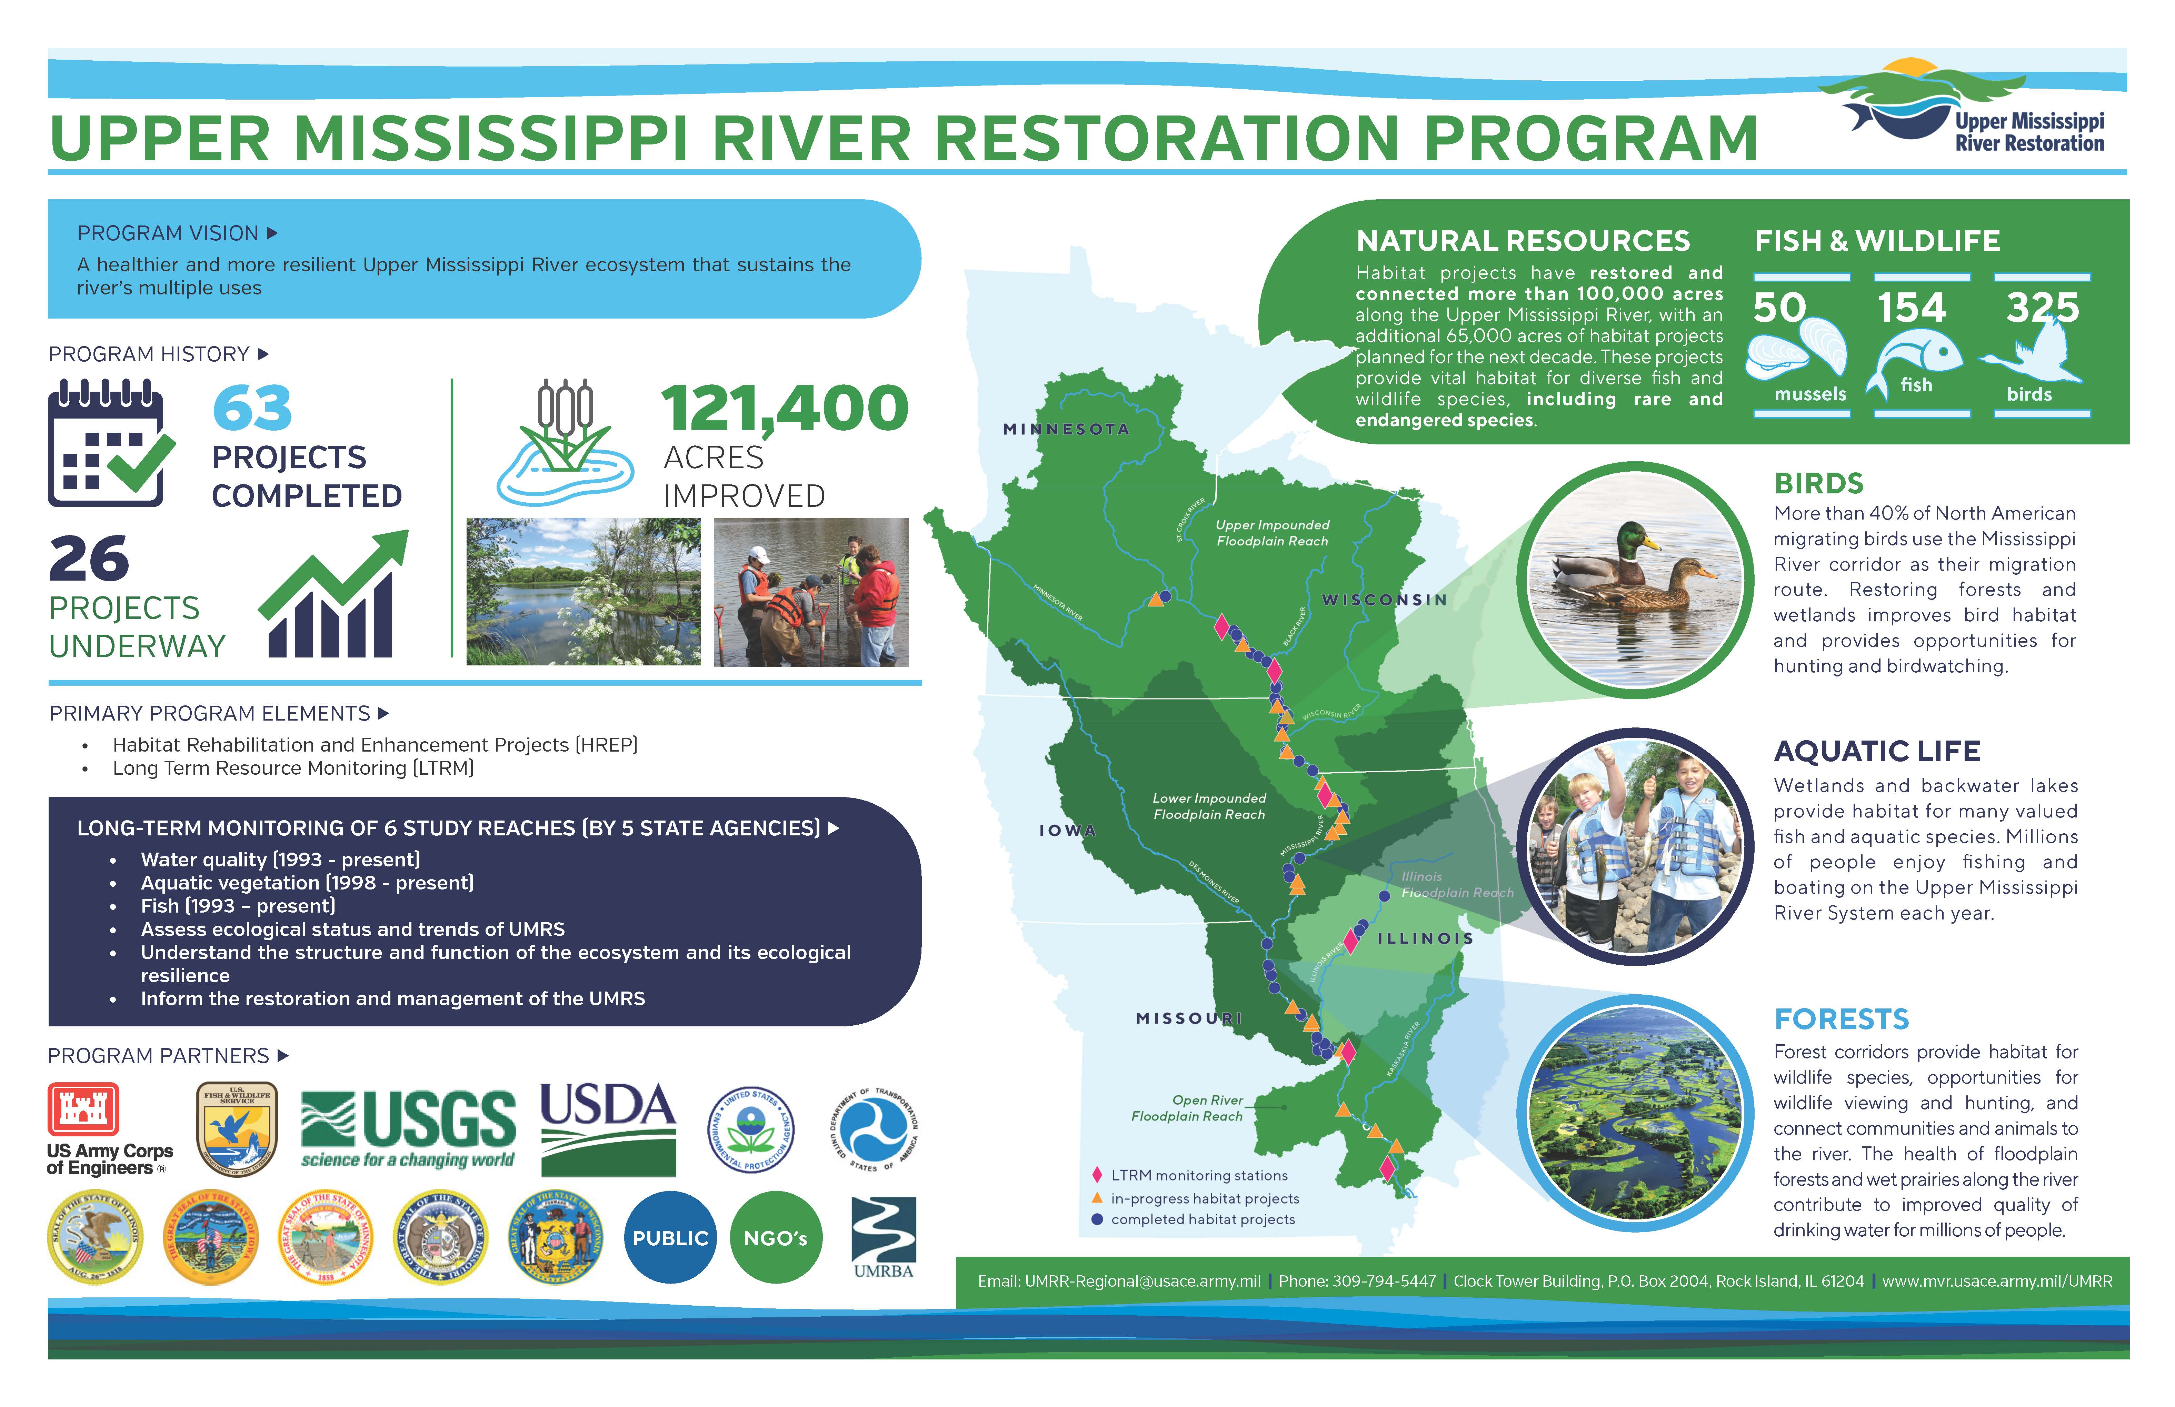
22

Slide 23
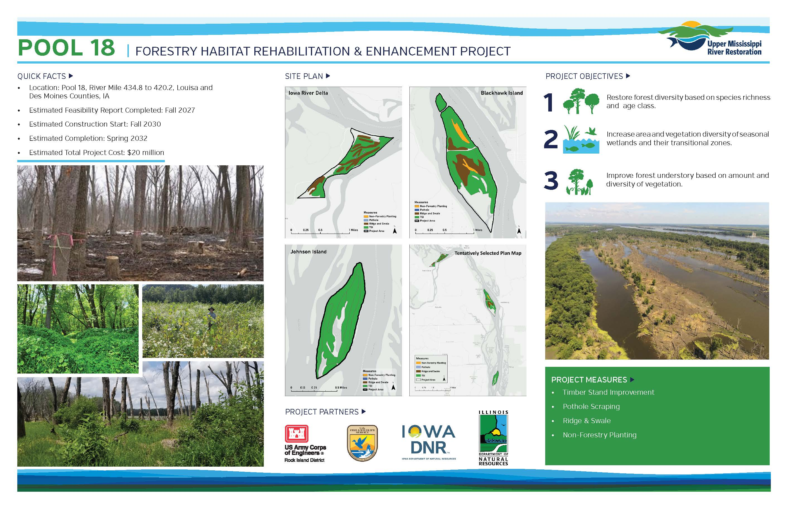

Slide 24
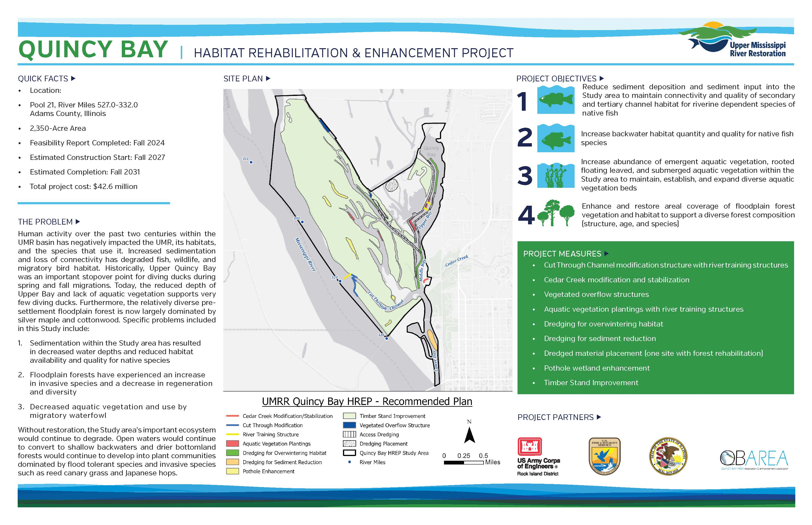

Slide 25
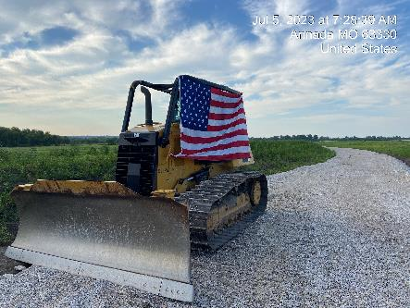
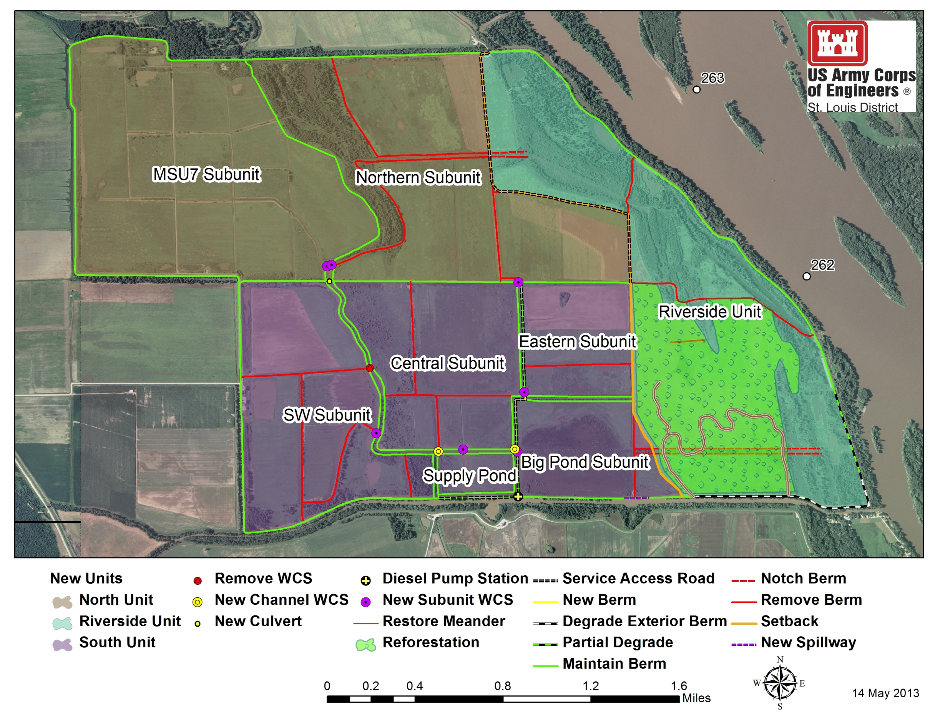
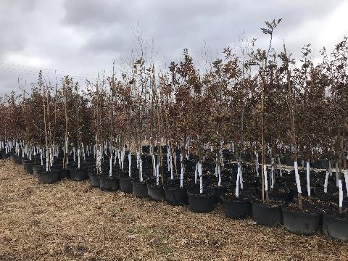
Clarence Cannon HREP
25

Slide 26
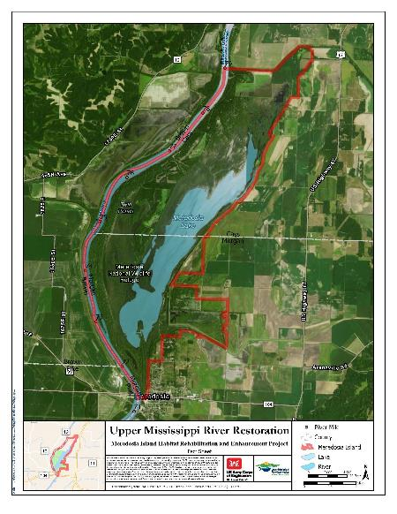

Meredosia Island Habitat Rehabilitation and Enhancement Project Upper Mississippi River Restoration Program
Location: Illinois River Miles 71.3-79.0, Left Descending Bank, Morgan and Cass Counties, upstream of Meredosia Illinois
US. Fish and Wildlife Service Owned 3,645 acres of federal lands and waters as part of the Meredosia National Wildlife Refuge Complex
Project Goals:
Increase depth diversity of backwater areas
Improve floodplain and aquatic vegetation diversity and abundance
Improve hydrological functioning and connectivity
Potential Solutions / Measures to meet the preliminary project objectives:
Berm modifications
Open water excavation
Flow modification
Water control structures
Timber stand improvement
Tree planting
Ridge and swale topography
Estimated Total Project Cost: $29.0M
26

Slide 27
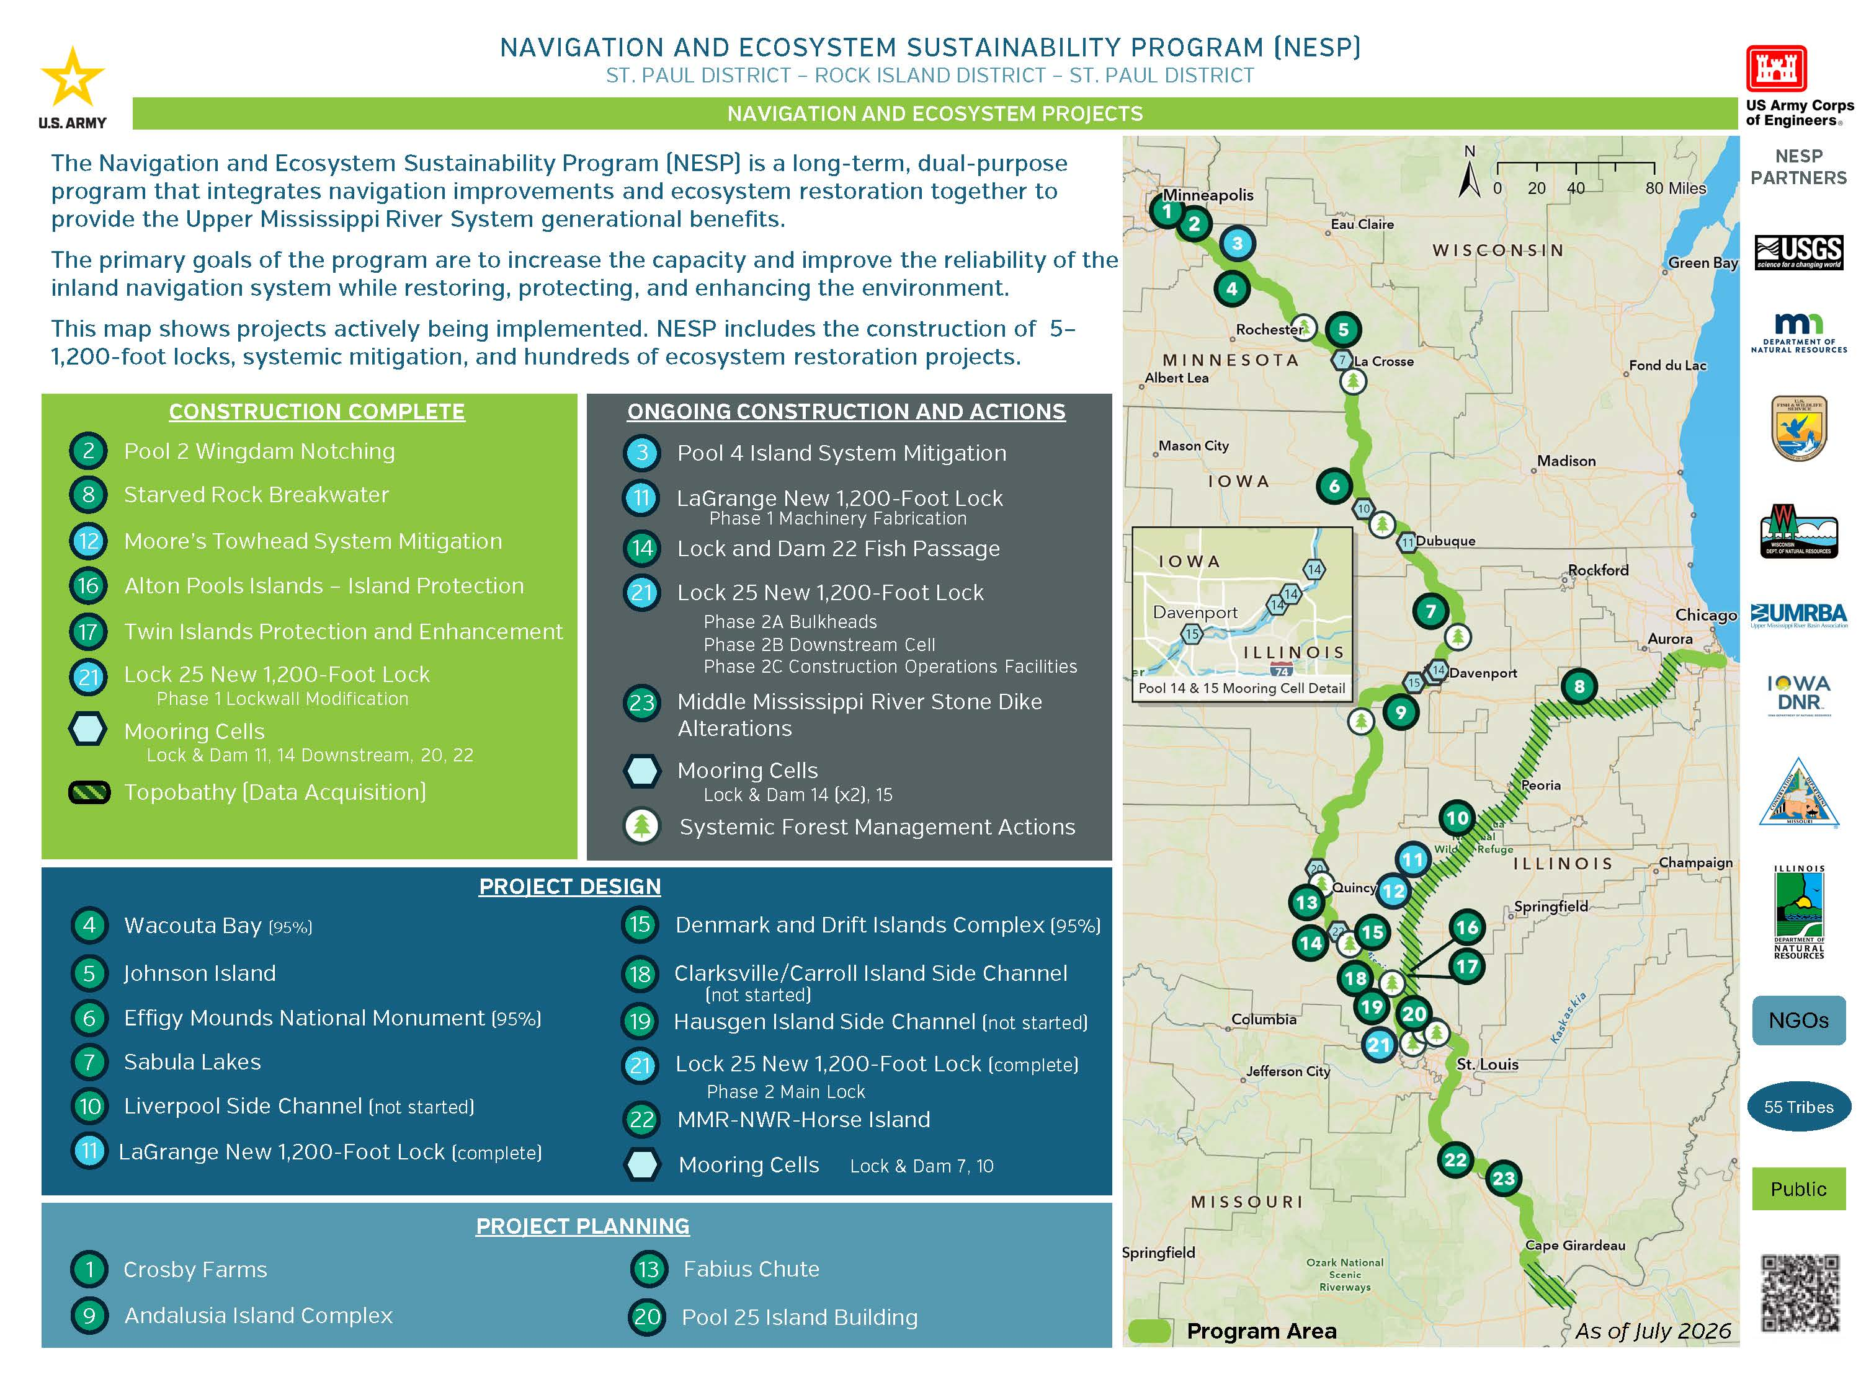
27

Slide 28

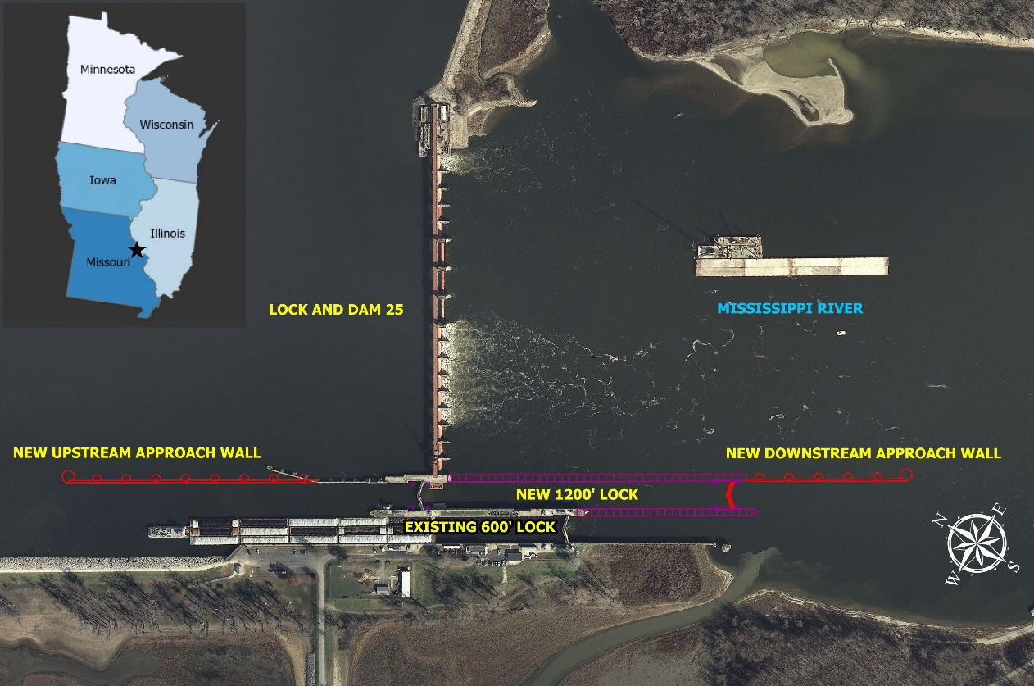
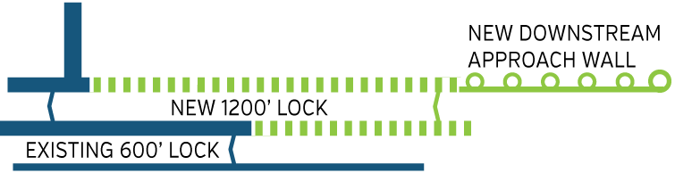

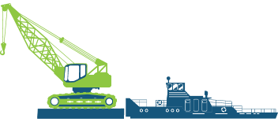





NAVIGATION AND ECOSYSTEM SUSTAINABILITY PROGRAM (NESP)
ST. PAUL DISTRICT- ROCK ISLAND DISTRICT - ST. LOUIS DISTRICT
As of 28-Jul-26
LOCK AND DAM 25 NEW 1,200-FOOT LOCK
PROJECT SUMMARY
Lock and Dam 25 is located in Calhoun County, Illinois, and Lincoln County, Missouri, at approximately river mile 241.4 on the Upper Mississippi River above the mouth of the Ohio River near Winfield, Missouri.
The primary purpose of the Lock and Dam 25 New 1,200-Foot Lock Project is to improve efficiency, reliability, and safety for navigation traffic transiting the facility along with operational redundancy at Lock 25.
The project will reduce the per lockage times from 2.5 hours or more to approximately 45 minutes. The addition of a 1,200-foot lock will accommodate the largest tow configurations on the Upper Mississippi River. This will improve mariner safety, with professional mariners no longer having to “split” tows to transit the lock chamber.
OBJECTIVES
PROJECT LOCATION
1
Safely deliver a quality 1,200-foot lock efficiently and cost effectively
2
Construct the project while minimizing impacts and maintaining predictability to existing navigation traffic
3
Navigation stakeholders will be integrated throughout the design and construction
  DESIGN OVERVIEW
  Phase 2 – Main Lock
  Design complete: 11 June 2026
  Solicitation: 14 July 2026
ACQUISITION OVERVIEW
Phase 2D – Lock Foundation and Site Preparation
  Award: 30 June 2026
CONSTRUCTION OVERVIEW
Construction Complete
  Phase 1 – Lockwall Modifications
Construction Ongoing
  Phase 2A – Bulkhead Supply
    Phase 2B – Downstream Cell
      Phase 2C – Construction -Operations Support Facilities
PROJECT SCHEDULE
ESTIMATEDCOST
>$500M
2022-2025
FALL 2027
FUNDING RECEIVED
100% DESIGN COMPLETE
CONSTRUCTION
0-95% DESIGN ACTIVITIES
CONSTRUCTION CONTRACT AWARDED
2022
SUMMER 2026
2027-2034
https://www.mvr.usace.army.mil/NESP/Navigation-Improvements/

Slide 29
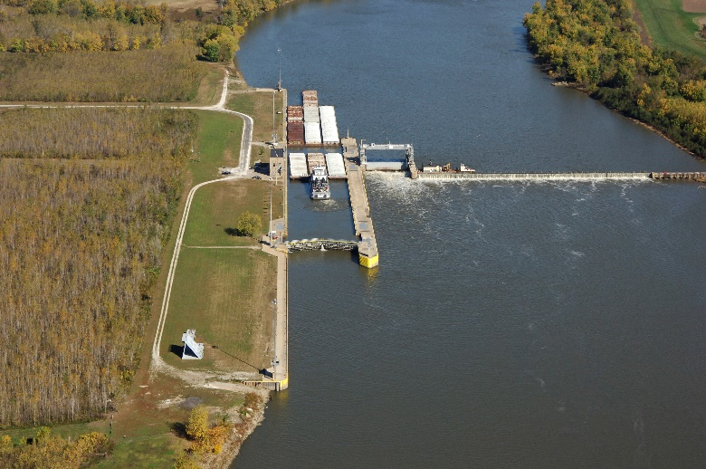
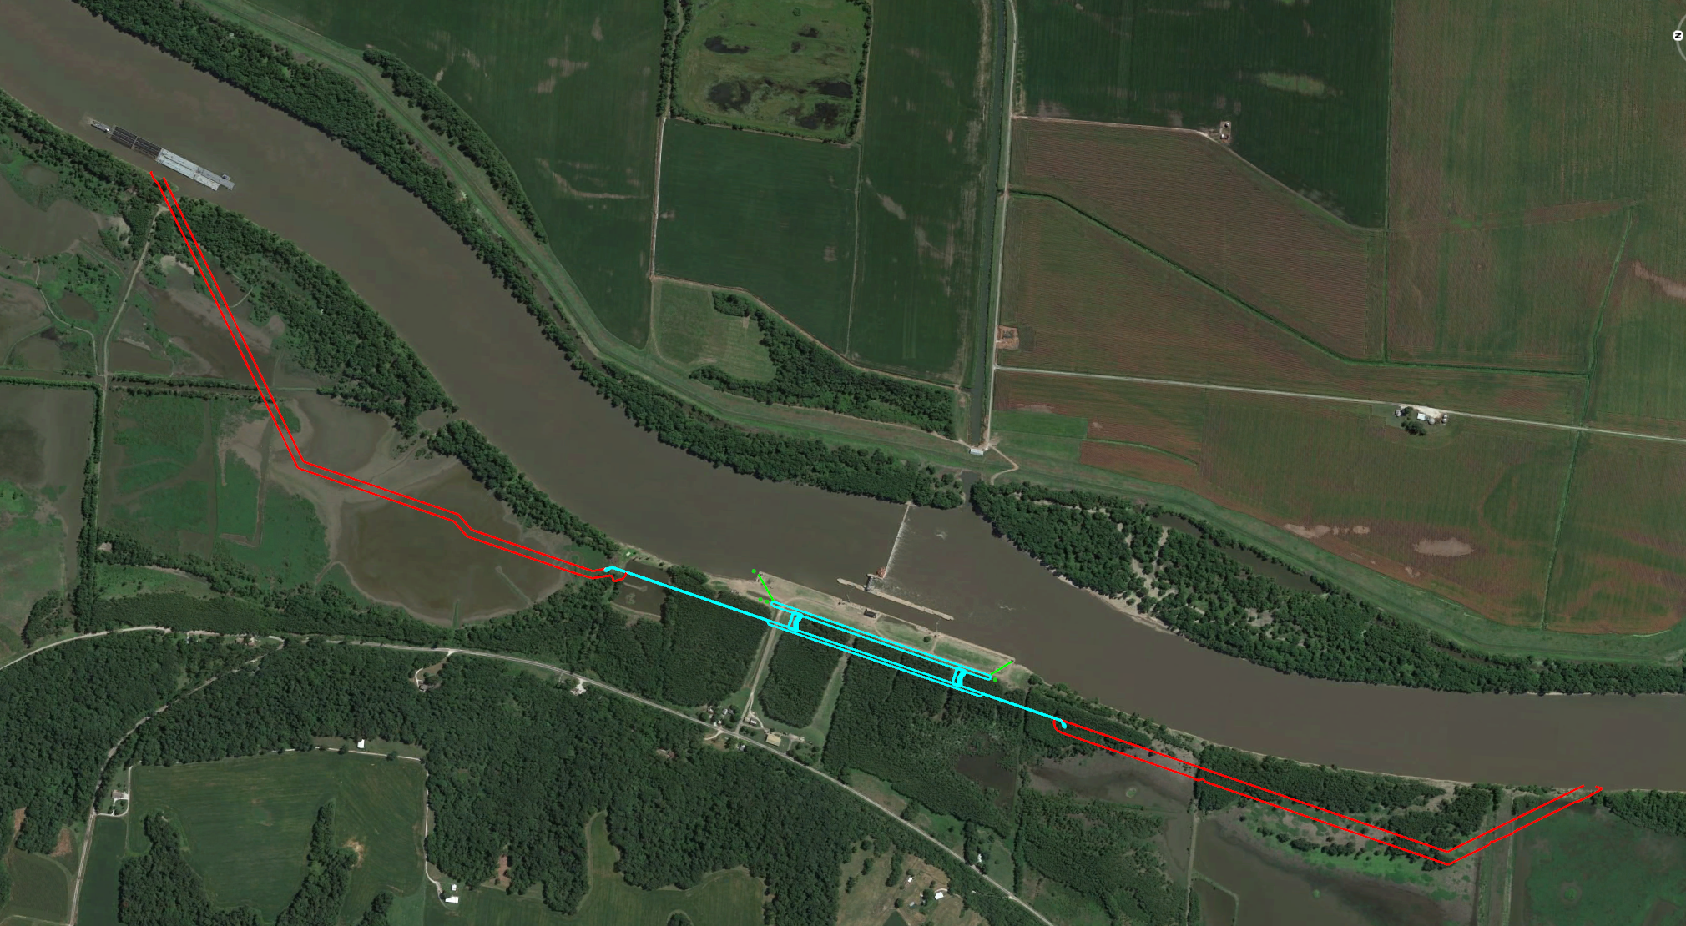
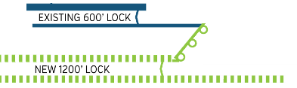

NAVIGATION AND ECOSYSTEM SUSTAINABILITY PROGRAM (NESP)
ST. PAUL DISTRICT- ROCK ISLAND DISTRICT - ST. LOUIS DISTRICT
As of 28-Jul-26
LAGRANGE NEW 1,200-FOOT LOCK
PROJECT SUMMARY
LaGrange Lock and Dam is 80.2 miles above the confluence of the Illinois River with the Mississippi River at Grafton, Illinois, 7.8 miles below Beardstown, Illinois.
The primary purpose of the LaGrange New 1,200-Foot Lock Project is to improve efficiency, reliability, and safety for navigation traffic transiting the facility along with additional operational redundancy at LaGrange.
The project will reduce the per lockage times from 2.5 hours or more to approximately 45 minutes. The addition of a 1,200-foot lock will accommodate the largest tow configurations on the Upper Mississippi River. This will improve mariner safety, with professional mariners no longer having to “split” tows to transit the lock chamber.
OBJECTIVES
1
New 1,200-foot navigation lock landward of the existing 600-foot lock
New Upstream
Channel Excavation
Left: Site plan for new 1,200-foot lock and upstream and downstream channels.
Above: Existing conditions include a 600-foot lock at LaGrange.
2
Construction will occur with minimal interference to existing navigation traffic
3
Existing 600-foot lock will remain in operation
Existing Lock
Illinois River
New 1200’ Lock
ONGOING ACTIVITIES
New Downstream
Channel Excavation
DESIGN OVERVIEW
100% design task order awarded
Real estate acquisition has begun
Industry coordination – navigation and construction ongoing
Design of new 1,200-foot lock complete
CONSTRUCTION OVERVIEW
Machinery fabrication underway with delivery expected in 2028
ESTIMATED
COST
> $500M
PROJECT SCHEDULE
FALL
2023
0-35%
DESIGN ACTIVITES
SUMMER 2023
REAL ESTATE ACQUISITION
2024-2026
CONSTRUCTION
PUBLIC
MEETING
2022-2023
INDUSTRY DAY
2023-2026
35 – 100% DESIGN ACTIVITIES
TBD
https://www.mvr.usace.army.mil/NESP/Navigation-Improvements/

Slide 30
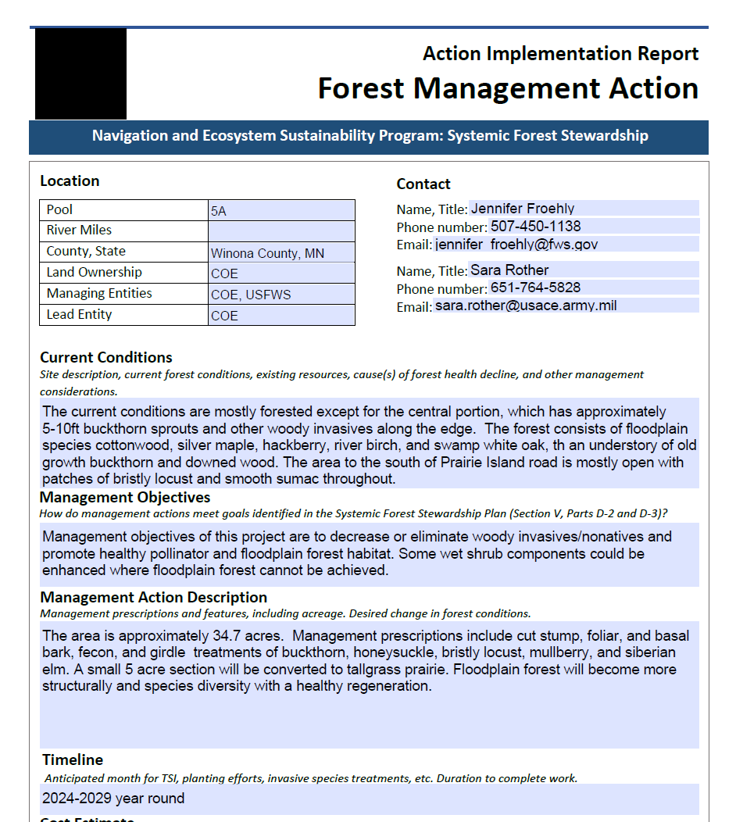
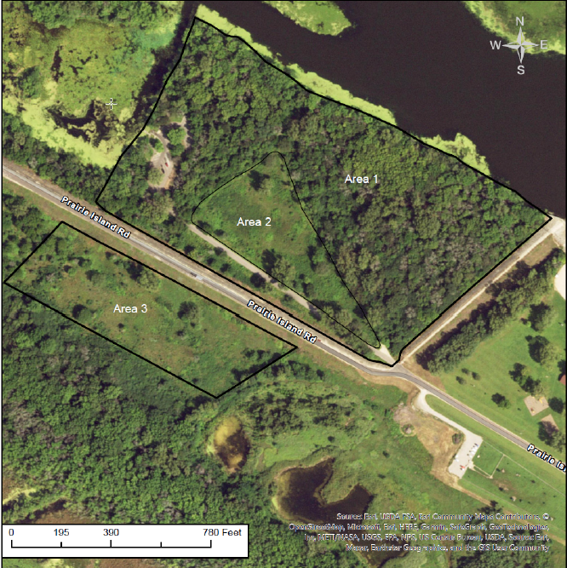








NAVIGATION AND ECOSYSTEM SUSTAINABILITY PROGRAM (NESP)
ST. PAUL DISTRICT- ROCK ISLAND DISTRICT - ST. LOUIS DISTRICT
As of 28-Jul-26
SYSTEMIC FOREST MANAGEMENT – MANAGEMENT ACTIONS
SUMMARY
The Systemic Forest Management Program will be implemented across the St. Paul, Rock Island, and St. Louis Districts. FY25 and FY26 implementation:
St. Paul District (MVP)
  McNally Landing Woody Invasive Control (Pool 6)
  Goose Island Woody Invasive Control (Pool 8)
Rock Island District (MVR)
  Bunker Chute Planting (Pool 11)
  Forest Inventory Contracts ( Pool 14 – Pleasant Creek, Pool 17, and Pool 21) – Complete
St. Louis District (MVS)
  Cuirve Island TSI and Tree Planting (Pool 26) – Complete
  Gilbert Island TSI and Tree Planting (Pool 26) – Complete
  Mile 215 TSI and Tree Planting (Pool26) – Complete
  Portage Island Invasive Species Control (Pool 26)
Forest Management Programmatic Environmental Assessment complete for all three districts.
1
The primary objectives are to increase species diversity, especially hard and soft mast producing species, to establish forest in non-forested openings, and to promote young forest. Other objectives include restoration of wet shrub habitat and reed canary grass control.
KEY ACTIVITIES
Site Preparation:
  Targeting Canopy Gaps: Focusing on areas with excessive reed canary grass, wood nettle, and bur cucumber. Areas will be forestry mulched then targeted for soil conditioning
  Soil Conditioning: Exposing bare soil to facilitate seed germination.
Planting:
  Containerized Trees: Planting swamp white and bur oak in canopy gaps.
  Planting wet shrubs and willow cuttings in lower elevation areas.
  Herbaceous Vegetation Control: Mowing or weed whacking to prevent competition.
PROGRAM PARTNERS
https://www.mvr.usace.army.mil/NESP/Ecosystem-Restoration/

Slide 31

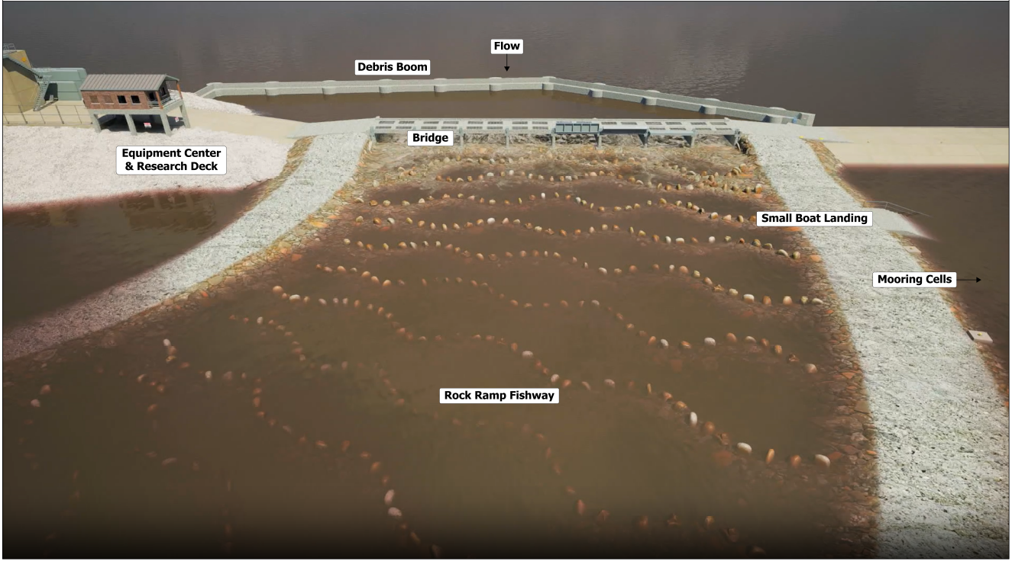
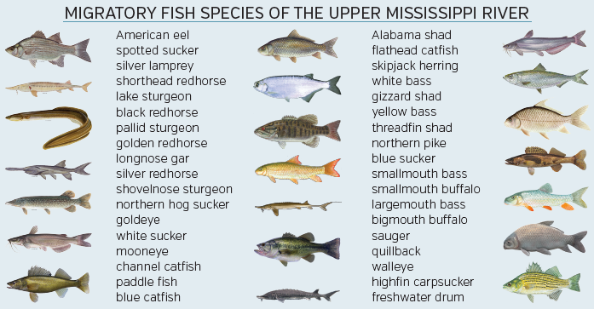


NAVIGATION AND ECOSYSTEM SUSTAINABILITY PROGRAM (NESP)
ST. PAUL DISTRICT- ROCK ISLAND DISTRICT - ST. LOUIS DISTRICT
As of 28-Jul-26
LOCK AND DAM 22 FISH PASSAGE
PROJECT SUMMARY
Lock and Dam 22 is located near Saverton, Missouri, on the Mississippi River, roughly 10 miles south of Hannibal, Missouri, at river mile 301.2. The fish passage structure will be constructed on the spillway portion of the dam, on the side furthest from the Illinois shoreline, and would extend downstream into the tailwater area.
The primary purpose of the Lock and Dam 22 Fish Passage Project is to increase fish access to upstream mainstream river and tributary habitats. Increased access to upriver habitat should result in an increase in the size and distribution of native migratory fish populations.
The secondary purpose is to monitor and adaptively manage this structure to optimize its effectiveness and inform design of subsequent fish passage projects.
DESIGN
HQUSACE approved Final PIR June 2022
Implementation Review Plan
Single Phase—Inlet Structure & Ice/Debris Structure; Rock Arch Fish Passage
CONSTRUCTION
Single Phase—Inlet Structure & Ice/Debris Structure; Rock Arch Fish Passage
ADAPTIVE MANAGEMENT
Pre-Construction Monitoring
Construction Monitoring
Post-Construction Monitoring
Adaptive Management
Infrastructure Investment & Jobs Act (IIJA) Funds: $97.1M, FY24 Congressionally Directed Spending: $25.5M
OBJECTIVES
1
2
3
4
Provide habitat benefits for over 30 fish species
Restore natural connection between pools
Increase migration capabilities for native fish species
Provide spawning habitat for fish
Project Deliverables & Tasks:
Mar 2024 – 100% Design Completion
Jun 2024 – Construction Solicitation
Sep 2024 – Construction Award
Sep 2027 – Construction Complete
Monitoring Activities
FY22-24 – Pre-Construction Monitoring
FY25-27 – Construction Monitoring
FY28-32 – Post-Construction Monitoring
FY28-32 – Adaptive Management
Lock and Dam 22 Fish Passage Monitoring
Inform Project Design and Construction
Monitor Fish Movement through Lock 22 and Fishway
Monitor Systemic Ecological Response by Migratory Fishes
Monitor Physical Performance of the Fish Passage Improvement Features
Monitor Effects of the Project on Structural Integrity, Navigation Operations, Water Quality
CONSTRUCTION
COST
$67.2M
PROJECT SCHEDULE
SPRING 2022
SPRING-FALL
2024
CONSTRUCTION AND MONITORING
FEASIBILITY APPROVAL
100% DESIGN COMPLETION
2027-2032
SUMMER 2022
START DESIGN
AND PRE-
CONSTRUCTION
MONITORING
WINTER
2023/2024
CONSTRUCTION SOLICITATION AND AWARD
2025-2027
POST-CONSTRUCTION MONITORING AND ADAPTIVE MANAGEMENT
PROGRAM PARTNERS
https://www.mvr.usace.army.mil/NESP/Ecosystem-Restoration/

Slide 32
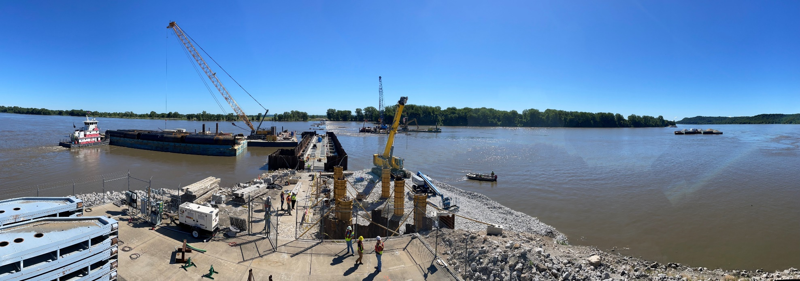
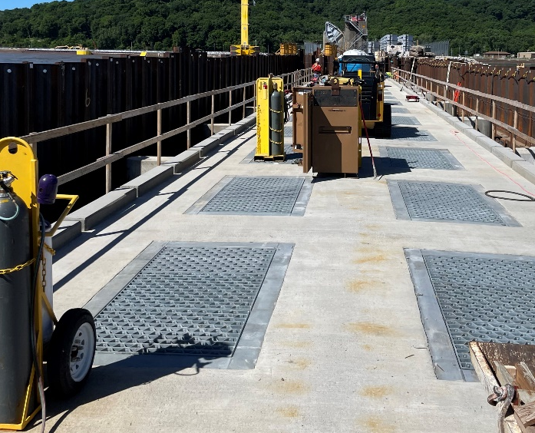
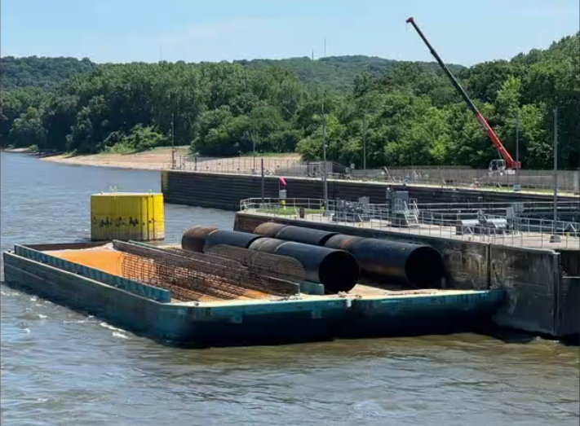
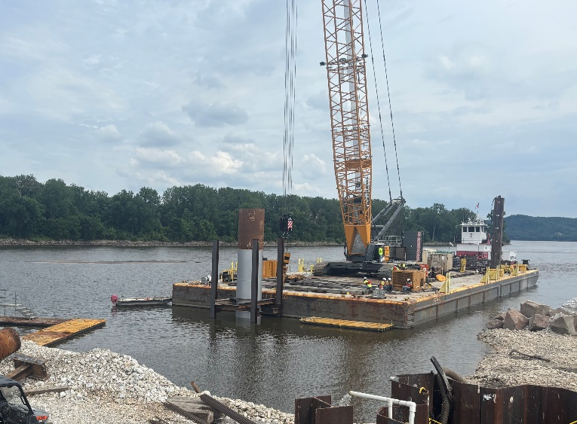
NAVIGATION AND ECOSYSTEM SUSTAINABILITY PROGRAM (NESP)
ST. PAUL DISTRICT- ROCK ISLAND DISTRICT - ST. LOUIS DISTRICT
As of 28-Jul-26
LOCK AND DAM 22 FISH PASSAGE- CONSTRUCTION PROGRESS
June 2026
Bridge
Debris Boom Pier Cages
Mooring Dolphin

Slide 33
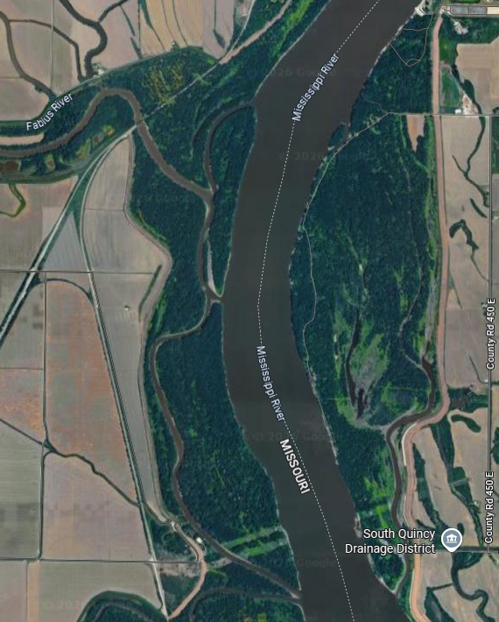
NAVIGATION AND ECOSYSTEM SUSTAINABILITY PROGRAM (NESP)
ST. PAUL DISTRICT- ROCK ISLAND DISTRICT - ST. LOUIS DISTRICT
As of 28-Jul-26
FABIUS CHUTE SIDE CHANNEL
PROJECT SUMMARY
The Fabius Chute Side Channel Project is located in Marion County, Missouri within Pool 22 of the Upper Mississippi River (UMR). Located on the confluence of the Fabius River near river mile 3223 and the Fabius Chute adjacent to Orton and Fabius Islands until it enters the UMR near river mile 321.
Sedimentation has severely degraded the side channel habitat, reducing the depth diversity and habitat structures within Fabius Chute. The primary purpose of the Fabius Chute Side Channel Project is to restore flow and depth diversity.
PROJECT AREA
PROJECT LOCATION
OBJECTIVES
1
2
Improve aquatic habitat for riverine fishes and freshwater mussels
Restore side channel connectivity and flow
POTENTIAL MEASURES
Construct hard points
Dredging to reconnect side channel
Opportunistic incorporation of woody structure
ESTIMATED
COST
$5 - 10M
PROJECT SCHEDULE
WINTER 2027
PUBLIC REVIEW OF DRAFT REPORT AND ALTERNATIVE
WINTER
2028
FINAL ENGINEERING DESIGN
ALTERNATIVE DEVELOPMENT
2030
PROJECT STATUS
Planning Kick Off July 2026
ALTERNATIVES SELECTED
FINALIZE REPORT
CONSTRUCTION
FALL 2026
SUMMER
2027
FALL 2028
PROGRAM PARTNERS
https://www.mvr.usace.army.mil/NESP/Ecosystem-Restoration/

Slide 34
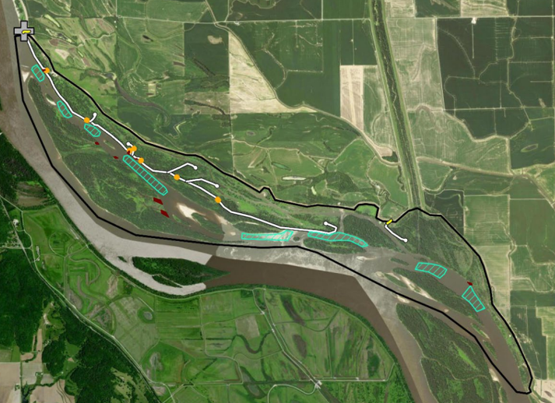

NAVIGATION AND ECOSYSTEM SUSTAINABILITY PROGRAM (NESP)
ST. PAUL DISTRICT- ROCK ISLAND DISTRICT - ST. LOUIS DISTRICT
As of 28-Jul-26
DENMARK AND DRIFT ISLANDS
PROJECT SUMMARY
Denmark and Drift Islands are located in Pool 24 between the river miles 295-289 of the Upper Mississippi River.
This area has seen an increase in sedimentation in recent years and recent large-scale flooding has exacerbated the problem. Water is currently unable to drain off these sites effectively following a flood, resulting in the degradation of floodplain forests and wetlands, as well as quality aquatic habitat.
The primary purpose of the Denmark and Drift Islands Project is to restore flow diversity, connectivity, and substrate diversity throughout project area (side channel, main channel, off channel, backwaters, etc.). This will improve the diversity of native aquatic and terrestrial vegetation and reduce the inundation hydroperiod on impacted forest stands.
.
OBJECTIVES
2
Improve existing timber stand and plant trees to increase forest habitat
Construct riffle structures to improve bed stability and provide habitat for aquatic species
1
3
4
Excavate backwater areas and sloughs to improve the diversity of aquatic vegetation
Notching of existing dike to improve habitat diversity
ESTIMATED
COST
> $10M
PROJECT SCHEDULE
SUMMER
2023
PUBLIC REVIEW OF DRAFT REPORT AND ALTERNATIVE
FALL
2024
FINAL ENGINEERING DESIGN
ALTERNATIVE DEVELOPMENT
2027
PROJECT STATUS
Project Implementation Report approved Jan 2025.
Design currently at 95%
2023
ALTERNATIVES
SELECTED
SPRING
2024
FINALIZE REPORT
Spring
2026
CONSTRUCTION
PROGRAM PARTNERS
https://www.mvr.usace.army.mil/NESP/Ecosystem-Restoration/

Slide 35

NAVIGATION AND ECOSYSTEM SUSTAINABILITY PROGRAM (NESP)
ST. PAUL DISTRICT- ROCK ISLAND DISTRICT - ST. LOUIS DISTRICT
As of 28-Jul-26
CLARKSVILLE & CARROLL ISLANDS
PROJECT SUMMARY
The Clarksville and Carroll Islands Project is located in Pool 25, between river miles 273-266 from Clarksville Island to Carroll Island and includes approximately 950 acres of side channel habitat along the Illinois bank.
Side channels are important aquatic habitat for many native species including Upper Mississippi River riverine fishes and freshwater mussels. Historically, the study area had freshwater mussel beds, but these beds have been impacted through time due to degraded side channel conditions (e.g., increased siltation, sediment homogenization).
The primary purpose of the Clarksville and Carroll Islands Project is to restore side channel connectivity and flow to benefit native riverine fish and wildlife. ​Additionally, this project will improve side channel habitat, including substrate stability, to benefit native freshwater mussels.
PROJECT LOCATION
Clarksville Island
OBJECTIVES
ESTIMATED
COST
$5 - 10M
1
2
Improve aquatic habitat for riverine fishes and freshwater mussels
Restore side channel connectivity and flow
TSP MEASURES
Dike alteration (including but not limited to removal, lowering, degrading, raising, extending, or notching)​
Rock-gravel substrate enhancement​
Dredging to reconnect side channel
Side channel enhancement dike
Carroll Island
PROJECT SCHEDULE
SUMMER 2023
SPRING
2025
PUBLIC REVIEW OF DRAFT REPORT AND ALTERNATIVE
FALL
2025
FINAL ENGINEERING DESIGN
ALTERNATIVE DEVELOPMENT
2029
PROJECT STATUS
Tentatively Selected Plan approved in February 2025
Final Report Approval June 2026
PROJECT INITIATION
ALTERNATIVE SELECTED
FINALIZE REPORT
CONSTRUCTION
2023-2024
SUMMER
2025
2027
PROGRAM PARTNERS
https://www.mvr.usace.army.mil/NESP/Ecosystem-Restoration/

Slide 36

NAVIGATION AND ECOSYSTEM SUSTAINABILITY PROGRAM (NESP)
ST. PAUL DISTRICT- ROCK ISLAND DISTRICT - ST. LOUIS DISTRICT
As of 28-Jul-26
HAUSGEN ISLAND
PROJECT SUMMARY
The Hausgen Island Project is located in Pool 25, between river miles 247-245, and includes approximately 250 acres of side channel habitat along the Missouri bank between Jim Crow and Hausgen islands.
Side channels are important aquatic habitat for many native species including Upper Mississippi River riverine fishes and freshwater mussels. Historically, the study area had freshwater mussel beds, but these beds have been impacted through time due to degraded side channel conditions (e.g., increased siltation, sediment homogenization).
The primary purpose of the Hausgen Island Project is to restore side channel connectivity and flow to benefit native riverine fish and wildlife. ​Additionally, this project will improve side channel habitat, including substrate stability, to benefit native freshwater mussels.
PROJECT LOCATION
OBJECTIVES
ESTIMATED
COST
$5 - 10M
Hausgen Island
1
2
Improve aquatic habitat for riverine fishes and freshwater mussels
Restore side channel connectivity and flow
Above: Lampsilis cardium
Right: Project location in Upper Mississippi River Pool 25
POTENTIAL MEASURES
Dike alteration (including but not limited to removal, lowering, degrading, raising, extending, or notching)​
River training structures​
Rock-gravel substrate enhancement​
Gradual slope revetment​
PROJECT SCHEDULE
SUMMER 2023
SPRING
2025
PUBLIC REVIEW OF DRAFT REPORT AND ALTERNATIVE
FALL
2025
ENGINEERING and DESIGN
ALTERNATIVE DEVELOPMENT
2029
PROJECT STATUS
Tentatively Selected Plan approved in February 2025
Final Report Approval May 2026
PROJECT INITIATION
ALTERNATIVE SELECTED
FINALIZE REPORT
CONSTRUCTION
2023-2024
SUMMER
2025
2027
PROGRAM PARTNERS
https://www.mvr.usace.army.mil/NESP/Ecosystem-Restoration/

Slide 37

37

